Slide 1
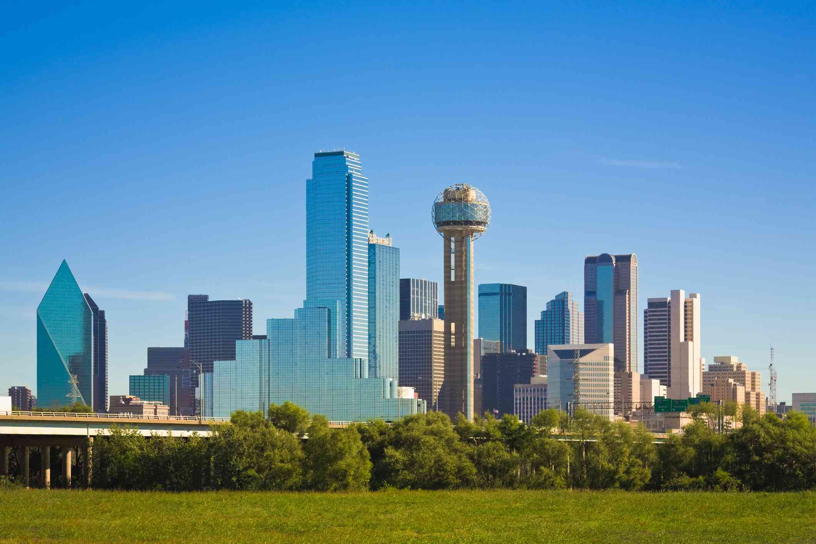

CRIME IN DALLAS
By Nimisha Pachory, Jon Patterson, Jay Streff, Viswanathan Subramanian, Brandon Wepking
Notes:
Hi everyone, thank you for joining us today- we are Team 6 and my team is Jon, Jay, Viswa and Brandon. Today we’re focusing on crime in the city of Dallas, Texas.

Slide 2


Presentation Overview
Context
Introduction to dataset
Questions we’re looking to answer
Intensity of crime by division
Violent crime
Rate of crimes
Response time of Dallas Police Department
Victim demographics
Conclusion/Recommendations
Notes:
This is how our presentation will be laid out- First we’ll set up the context, introduce our dataset as well as pose some questions that we want to answer at the outset. We then will look at spikes in crime by division and then identify trends in violent crime. Then we’ll look at rates of crimes, response time of the DPD- Dallas Police department. Towards the end, we’ll look at some victim demographics and present our conclusions and recommendations.

Slide 3
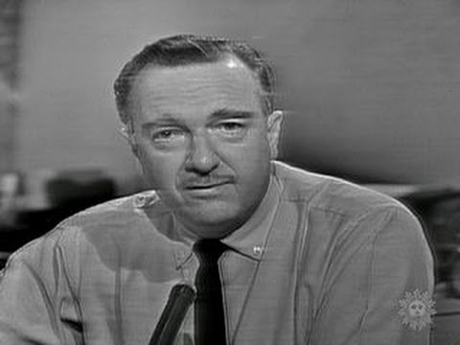
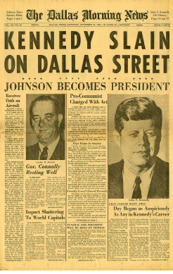
56 Years Ago...
CBS News Broadcast: November 22, 1963
Notes:
56 years ago- Dallas was the scene of one of the darkest chapters in American history, when President Kennedy was assassinated in downtown Dallas. That earned Dallas a reputation for being ‘The City of Hate” and being unsafe.

Slide 4
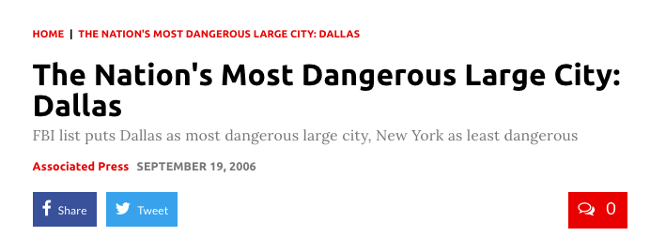
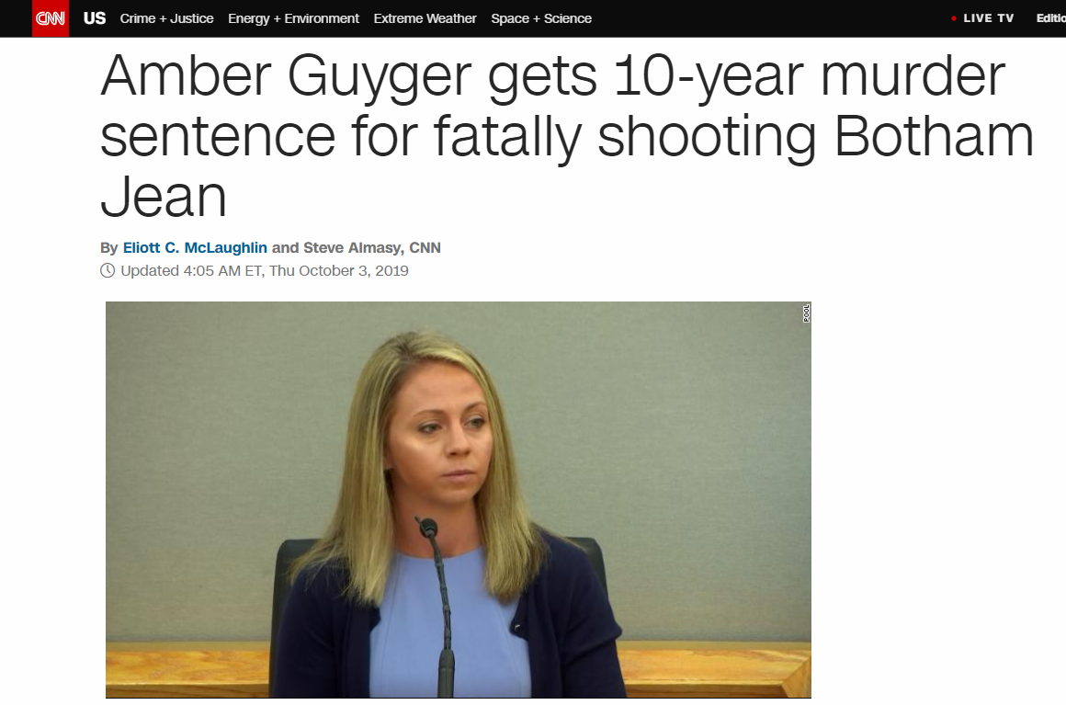
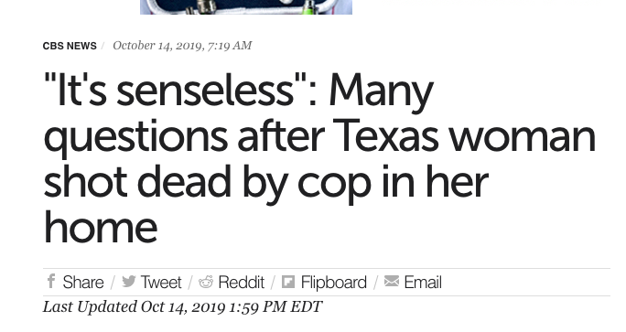
Dallas is STILL Dangerous, Y’all
Notes:
Today- Dallas still struggles with that tag. There was a lot of media attention on the city recently, when Amber Guyger, the cop who killed a man in his apartment was sentenced to 10 years in prison. It’s classified as the nation’s most dangerous large city by the FBI and law & order in Dallas continues to be quite alarming..

Slide 5


Data
Dataset downloaded from City of Dallas website
Contains Incidents beginning June 1, 2014 to current-date
Started with 100 columns, 600,000 rows of data
Cleaned dataset to 2018 incidents alone, deleted surplus columns and were left with ~30 columns and 100,000 rows
Notes:
Our data was sourced from an open website operated by the City of Dallas- it’s called DallasOpenData.com. Our initial dataset began in 2014 and spanned current data. At the outset, we had 100 columns and 600,000 rows. We cleaned this up using R and were left with incidents from 2018, 30 columns and 100,000 rows.

Slide 6
Questions
Where is crime concentrated in Dallas?
What are the response rates of the Dallas Police Department?
Which is the most vulnerable section of Dallas society?

Slide 7
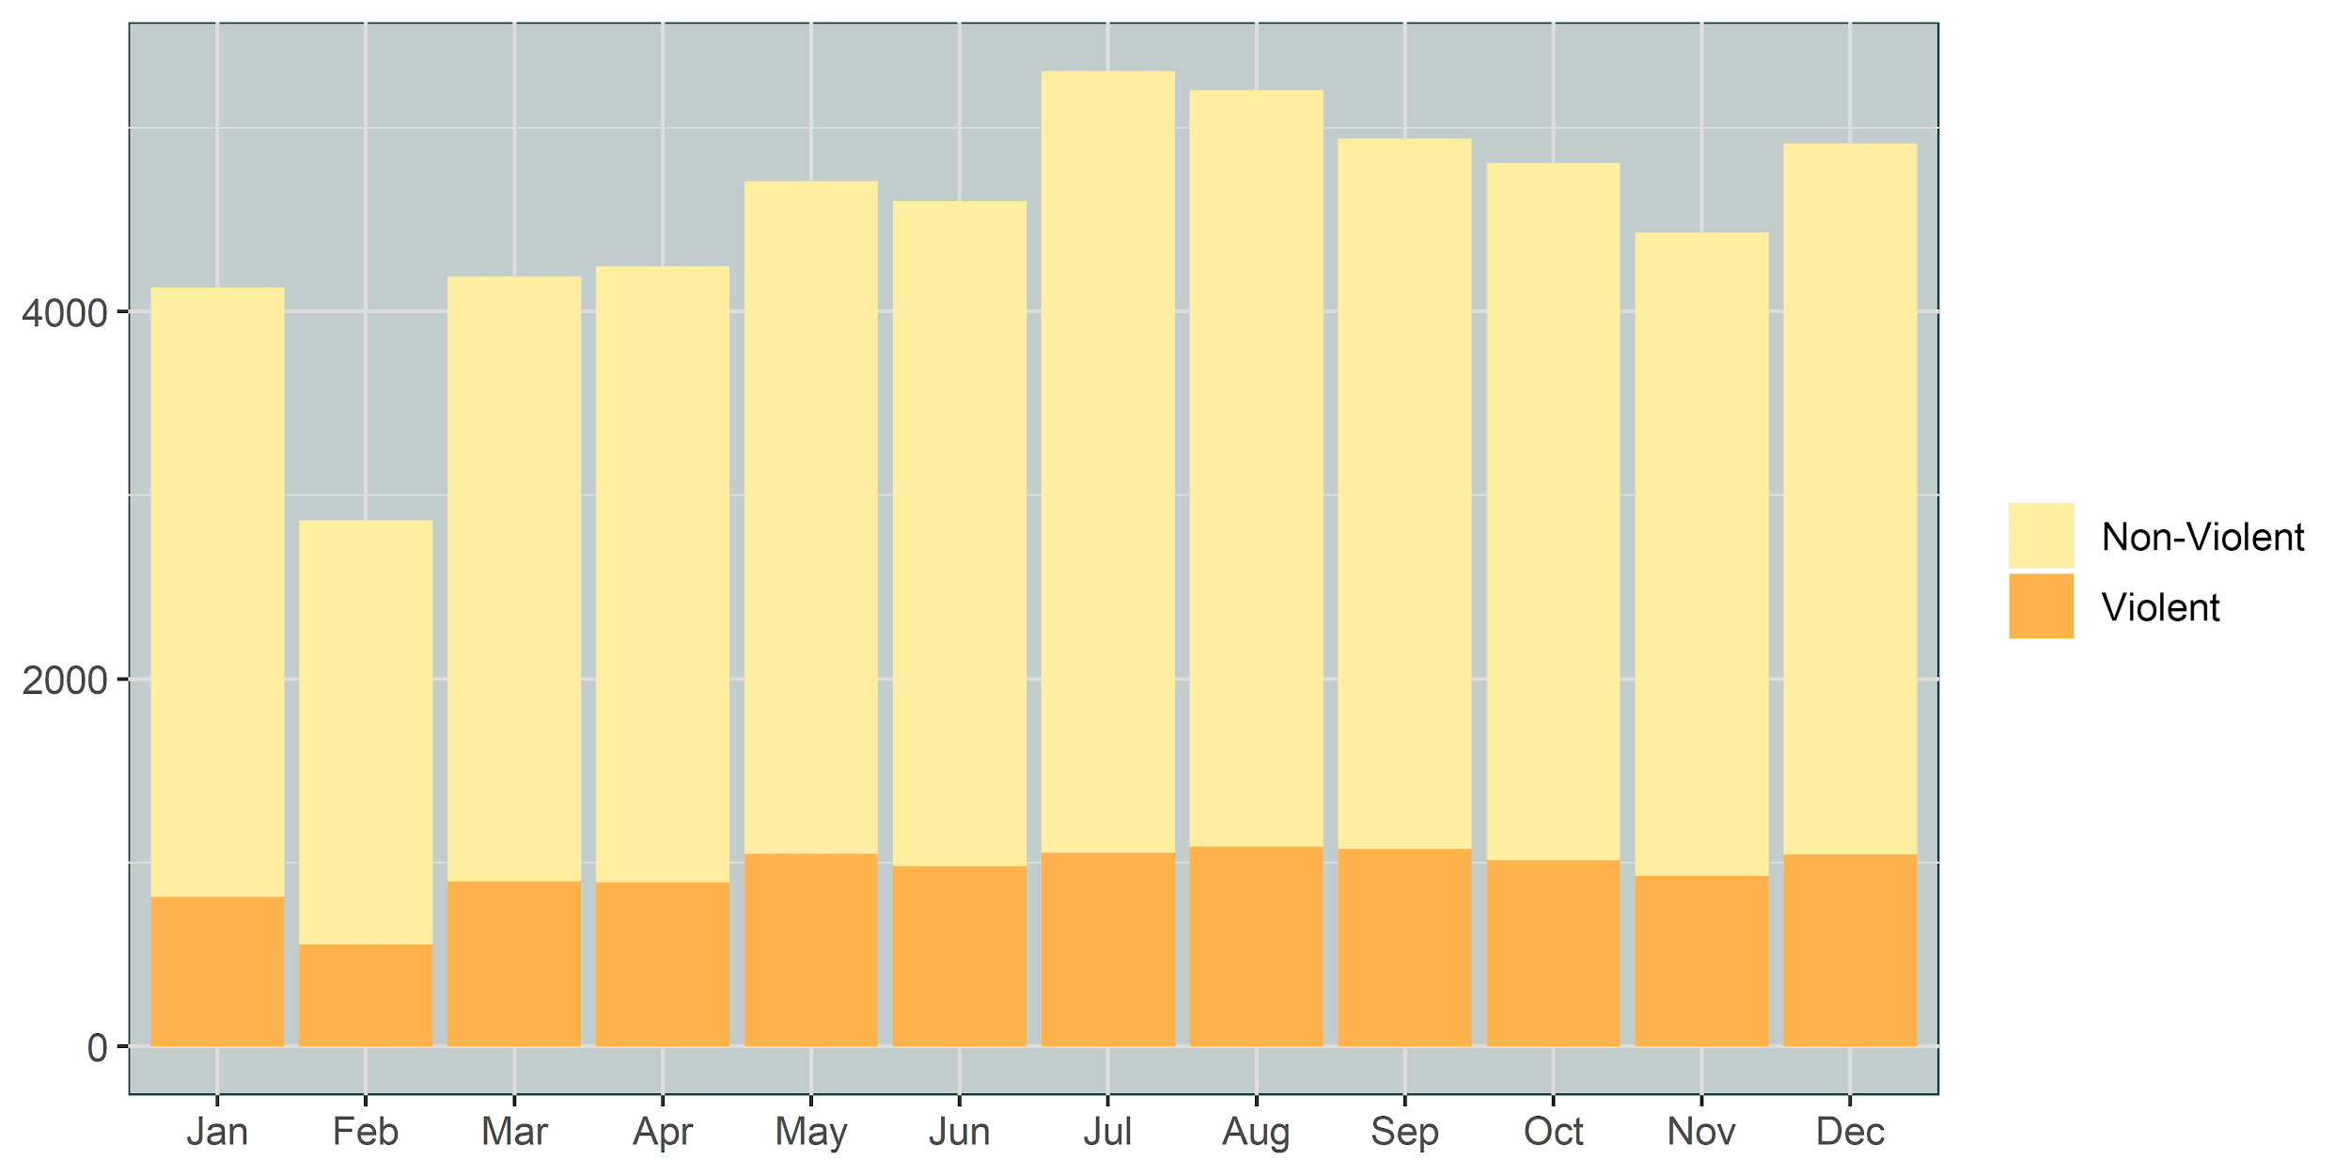
Top 10 Police Incidents by Month
Notes:
Major jump in July - what happened? In 2018, the Dallas police department transitioned from Uniform Crime REporting to National Incident Based REporting System (NIBRS). Overall, this should be a positive for the department as it allows for more detailed recording of police incidents, however it is not apples to apples. One of the major differences is that under UCR, only the “highest” offense was recorded - one record for one incident. However, under NIBRS, each crime is recorded; for example, an assault and theft would result in two NIBRS incidents. News articles from 2018 and 2019 speak to the positive nature of the change, while also lamenting that it has made a true apples to apples comparison with 2017 very challenging. It is worth noting that we don’t see the same level of “spike” in violent crime, which i’ll get into a little later, during the year.
When we look at overall police incidents, we can see that there are clear upticks in the summer months…
heat of summer months drives crime up

Slide 8
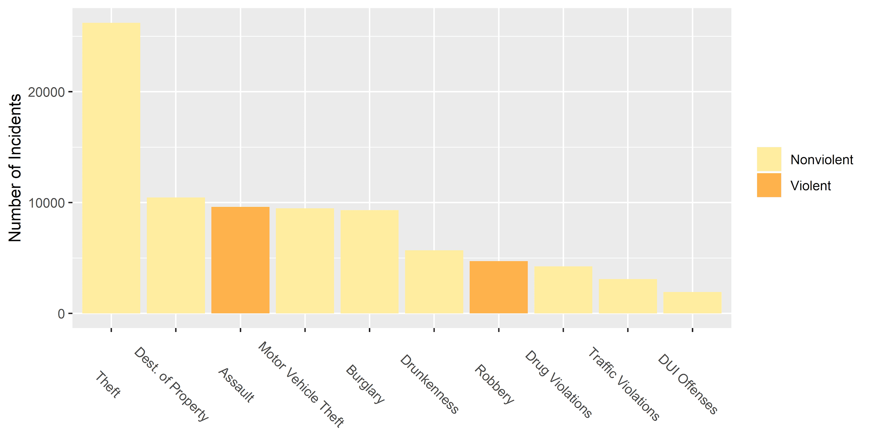
Top 10 Police Incidents
Notes:
clarify 2018 data / two color scale
Code for graph:
df_crime_category <- sort(table(df$NIBRS_Crime_Category), decreasing = TRUE)
df_crime_category <- as.data.frame(df_crime_category[df_crime_category > 100])df
df_crime_category <- df_crime_category[-c(1,9), ]
df_crime_category <- rename (df_crime_category, Category = Var1)
df_crime_category <- rename (df_crime_category, Frequency = Freq)
levels(df_crime_category$Category) <- c("MISCELLANEOUS", "Theft", "Vandalism", "Assault", "Motor Vehicle Theft", "Burglary", "Drunkenness", "Robbery", "ALL OTHER OFFENSES", "Drug Violation", "Traffic Violation", "DUI Offense", "FRAUD OFFENSES", "TRESPASS OF REAL PROPERTY", "FAMILY OFFENSES, NONVIOLENT", "WEAPON LAW VIOLATIONS", "COUNTERFEITING/FORGERY", "TRAFFIC VIOLATION- NON HAZARDOUS", "EMBEZZELMENT", "DISORDERLY CONDUCT", "ARSON", "ANIMAL OFFENSES")
df_crime_category <- df_crime_category[c(1:10), ]
bp <- ggplot(df_crime_category, aes(x=Category, y=Frequency, fill=Category)) + geom_bar(stat="identity") + theme(axis.text.x=element_blank())
bp <- bp + theme(axis.title.x = element_blank())
bp <- bp + theme(axis.title.y = element_blank())
bp <- bp + theme(plot.title = element_text(size = 28, face = "bold"))
bp <- bp + theme(text = element_text(size = 12))
use the pallet to represent the severity of offenses (?)
use two color scheme to represent violent vs nonviolent crime, move category to labels
NIBRS code talk about what that is - difference in coding for 2018 vs 2017

Slide 9
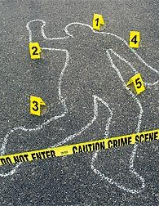
Violent Crimes
Crime categories that include Assault, Homicide or Robbery
This subset has just under 15,000 records from 2018
Notes:
The FBI defines violent crime as assaults, homicides, robbery, and sexual assault. Our dataset does not contain data on police incidents involving sexual assault due to privacy/confidentiality concerns.
privacy standpoint - a lot of cases in under 18 not released, and no sexual assault data

Slide 10
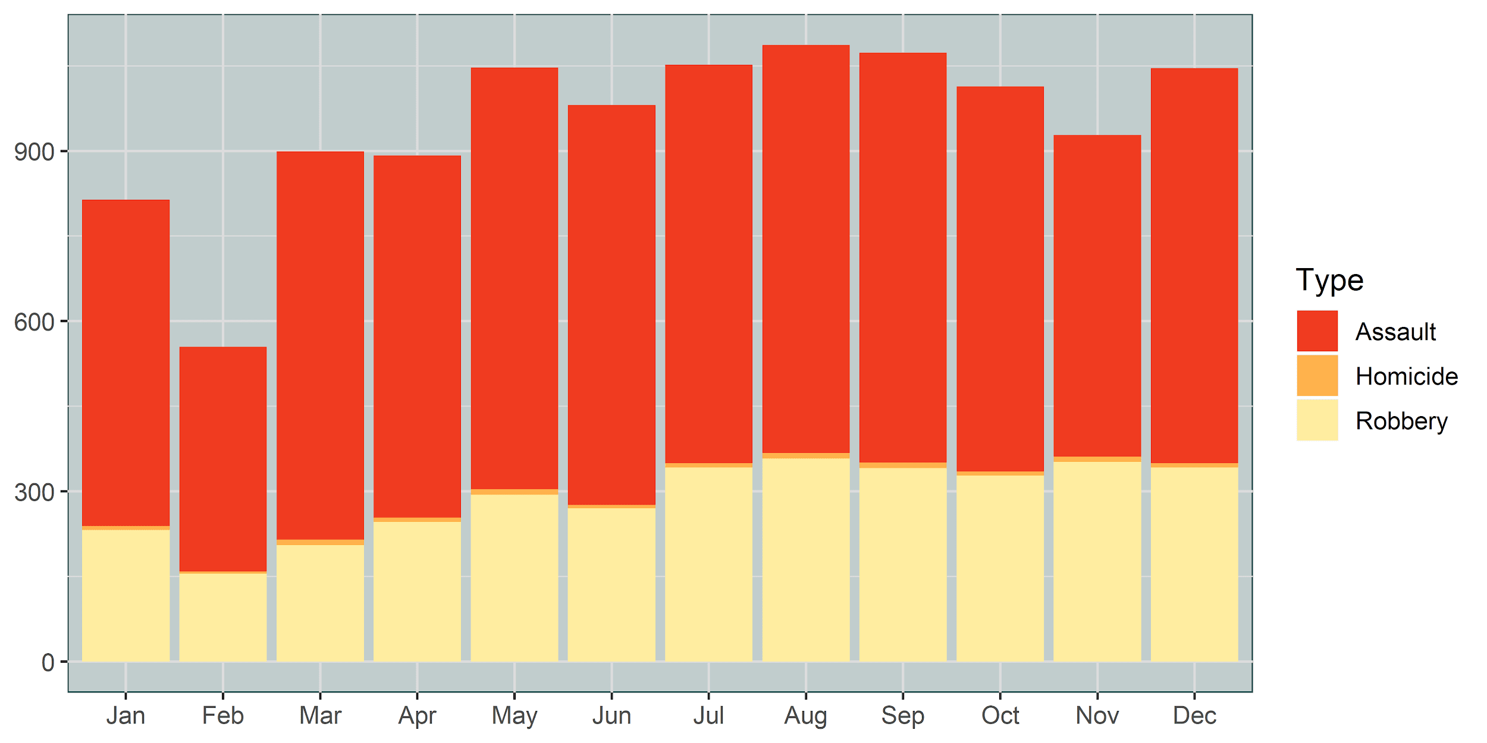
Violent Crime by Month
Notes:
Narrowing in on just the violent crime we see the same trends, although these only represent about 5-10% of overall police incidents in the Dallas area. The month by month trending here mirrors 2017 much more closely, suggesting that the month to month changes reflect actual crime trends as opposed to adoption of a new coding system.

Slide 11
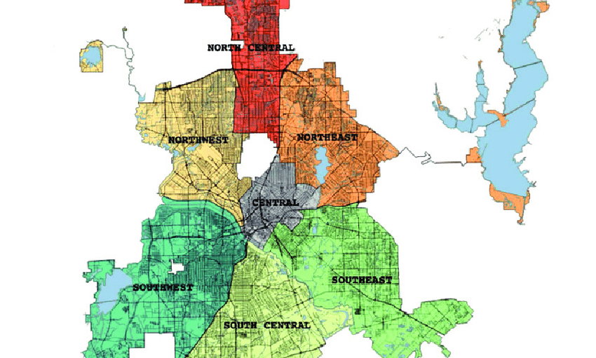
Divisions of Dallas
Notes:
Each Division operates somewhat autonomously - each district - defined as smallest police geography

Slide 12
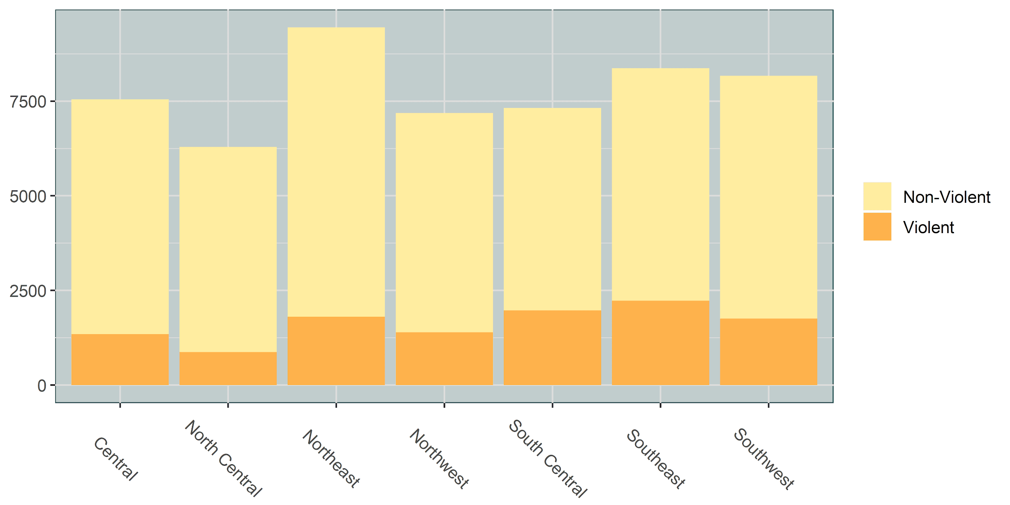
Total Police Incidents by Division
Notes:
Each Division operates somewhat autonomously - they each have their own mayor - defined as smallest police geography

Slide 13
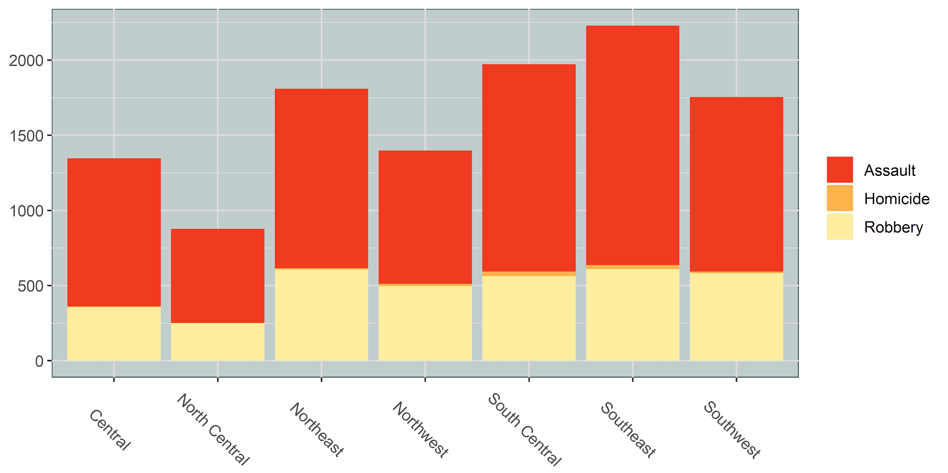
Violent Crimes by Division
Notes:
Each Division operates somewhat autonomously - they each have their own mayor - defined as smallest police geography

Slide 14
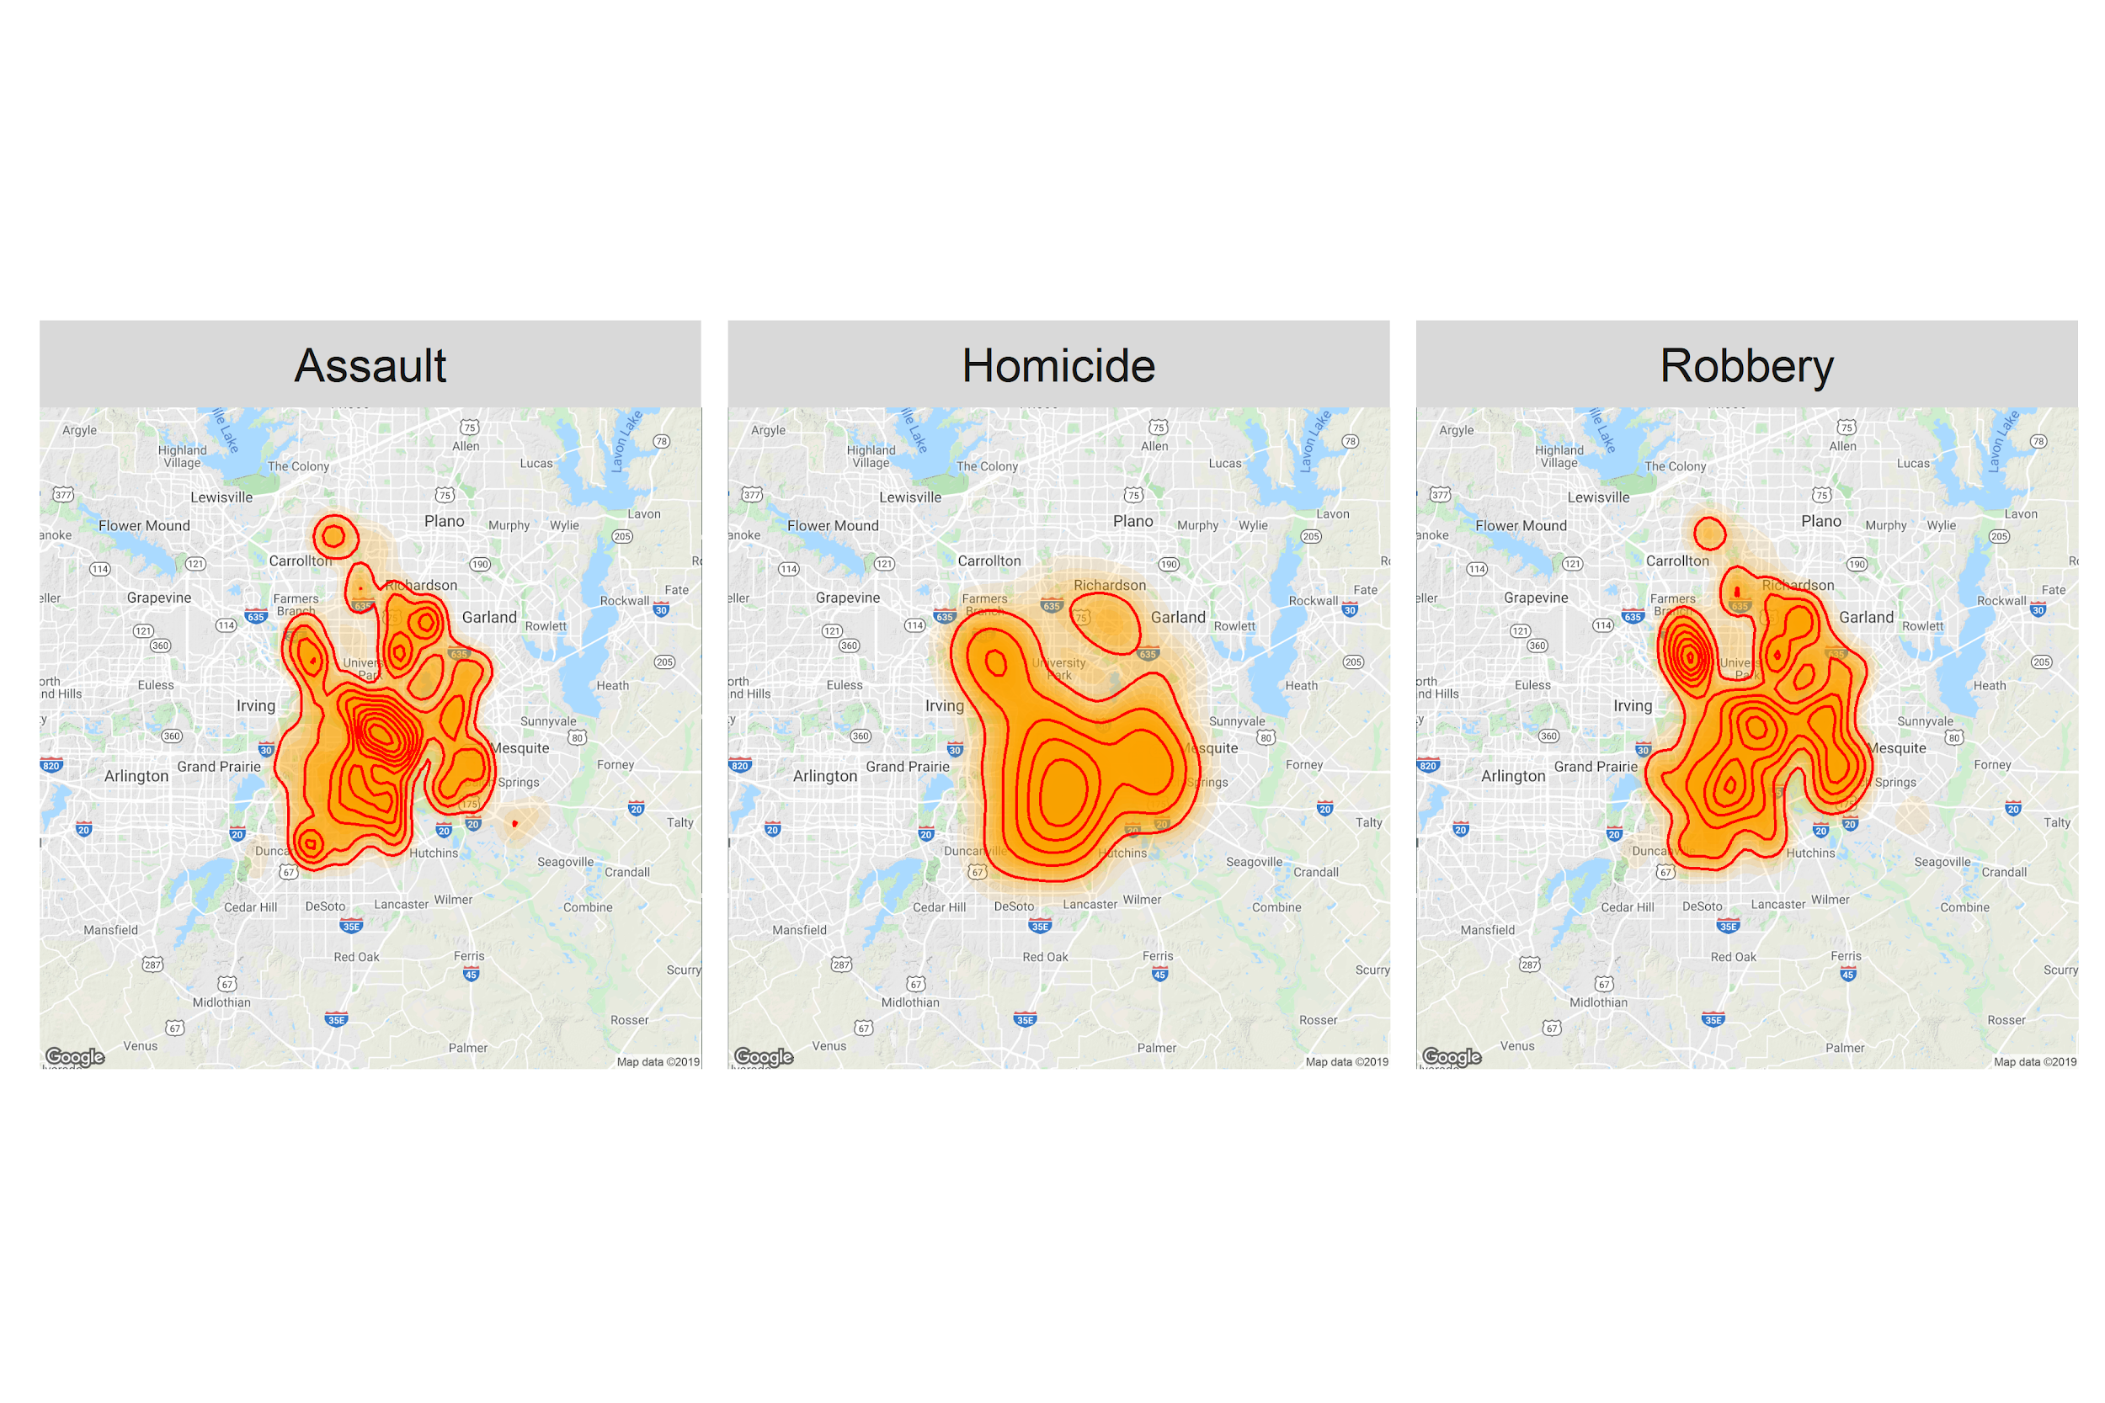
Concentration of Violent Crime

Slide 15
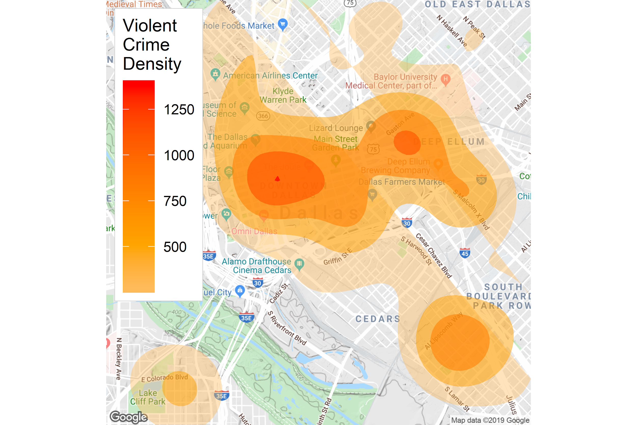
Overall Violent Crime Density

Slide 16
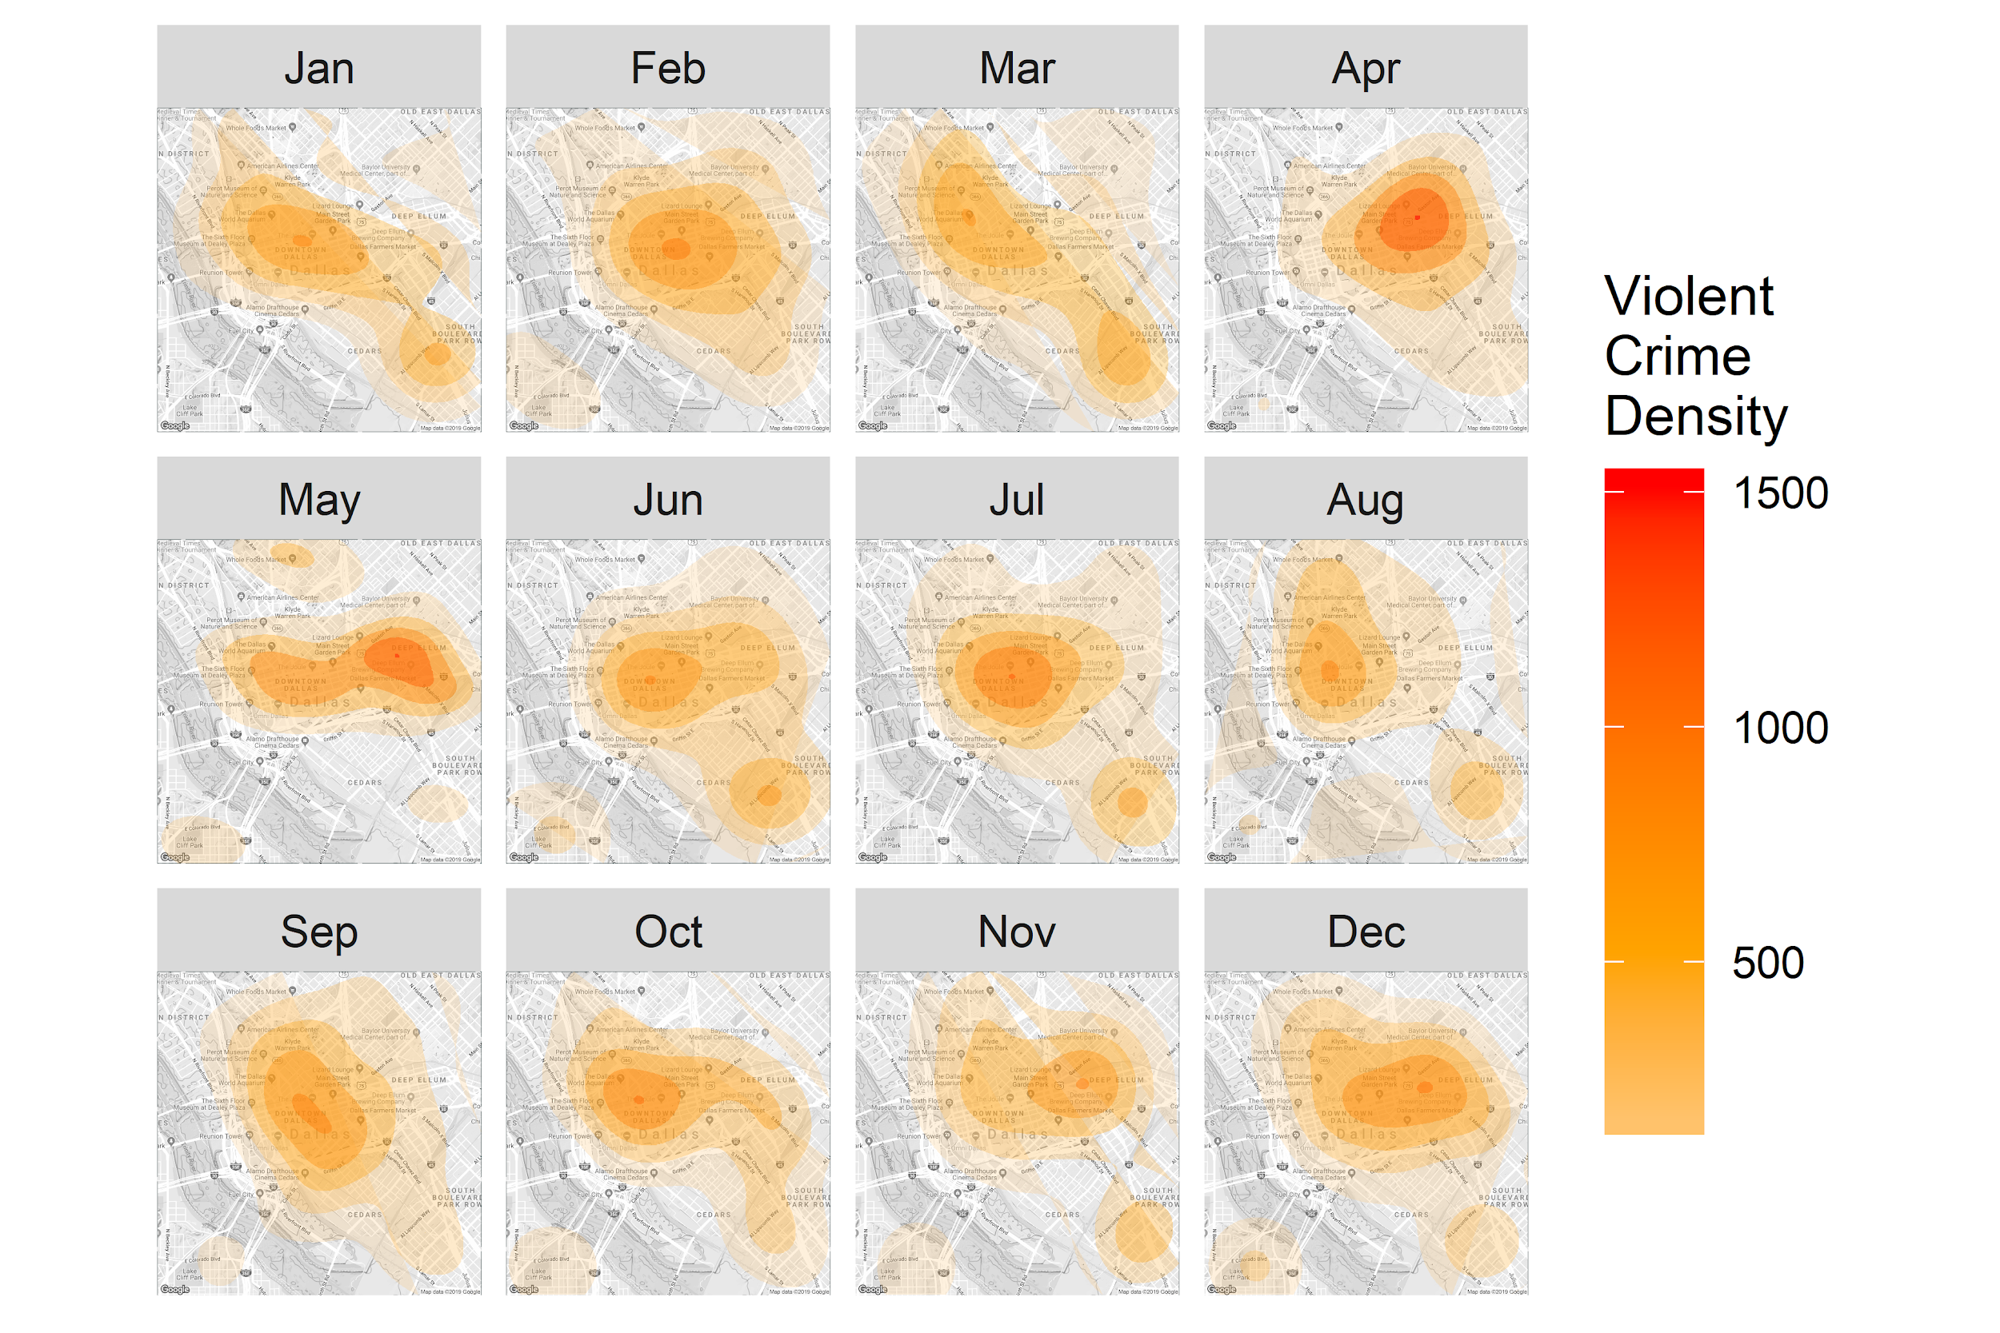
Violent Crime Density by Month
Notes:
Slice over time and shifting over the year
Two distinct hot spots
Dallas temps in the summer

Slide 17
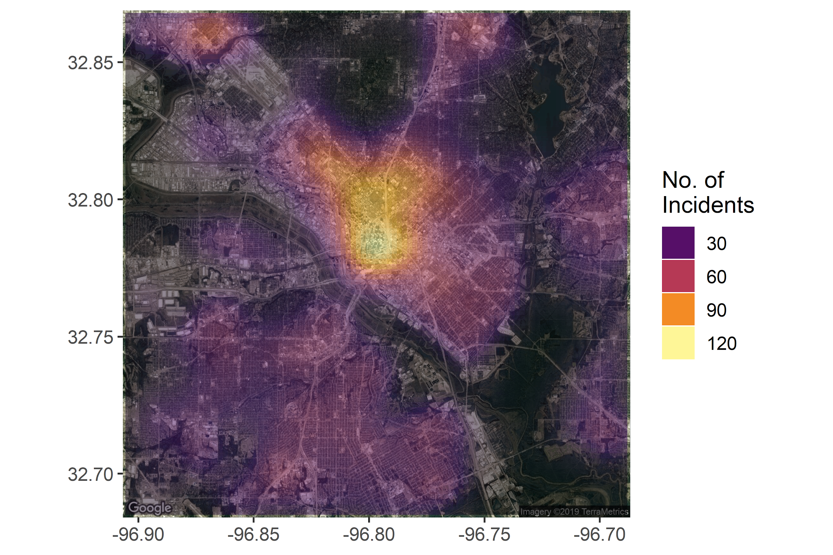
Heat Map of Crimes
Notes:
asdfasdfasdf

Slide 18
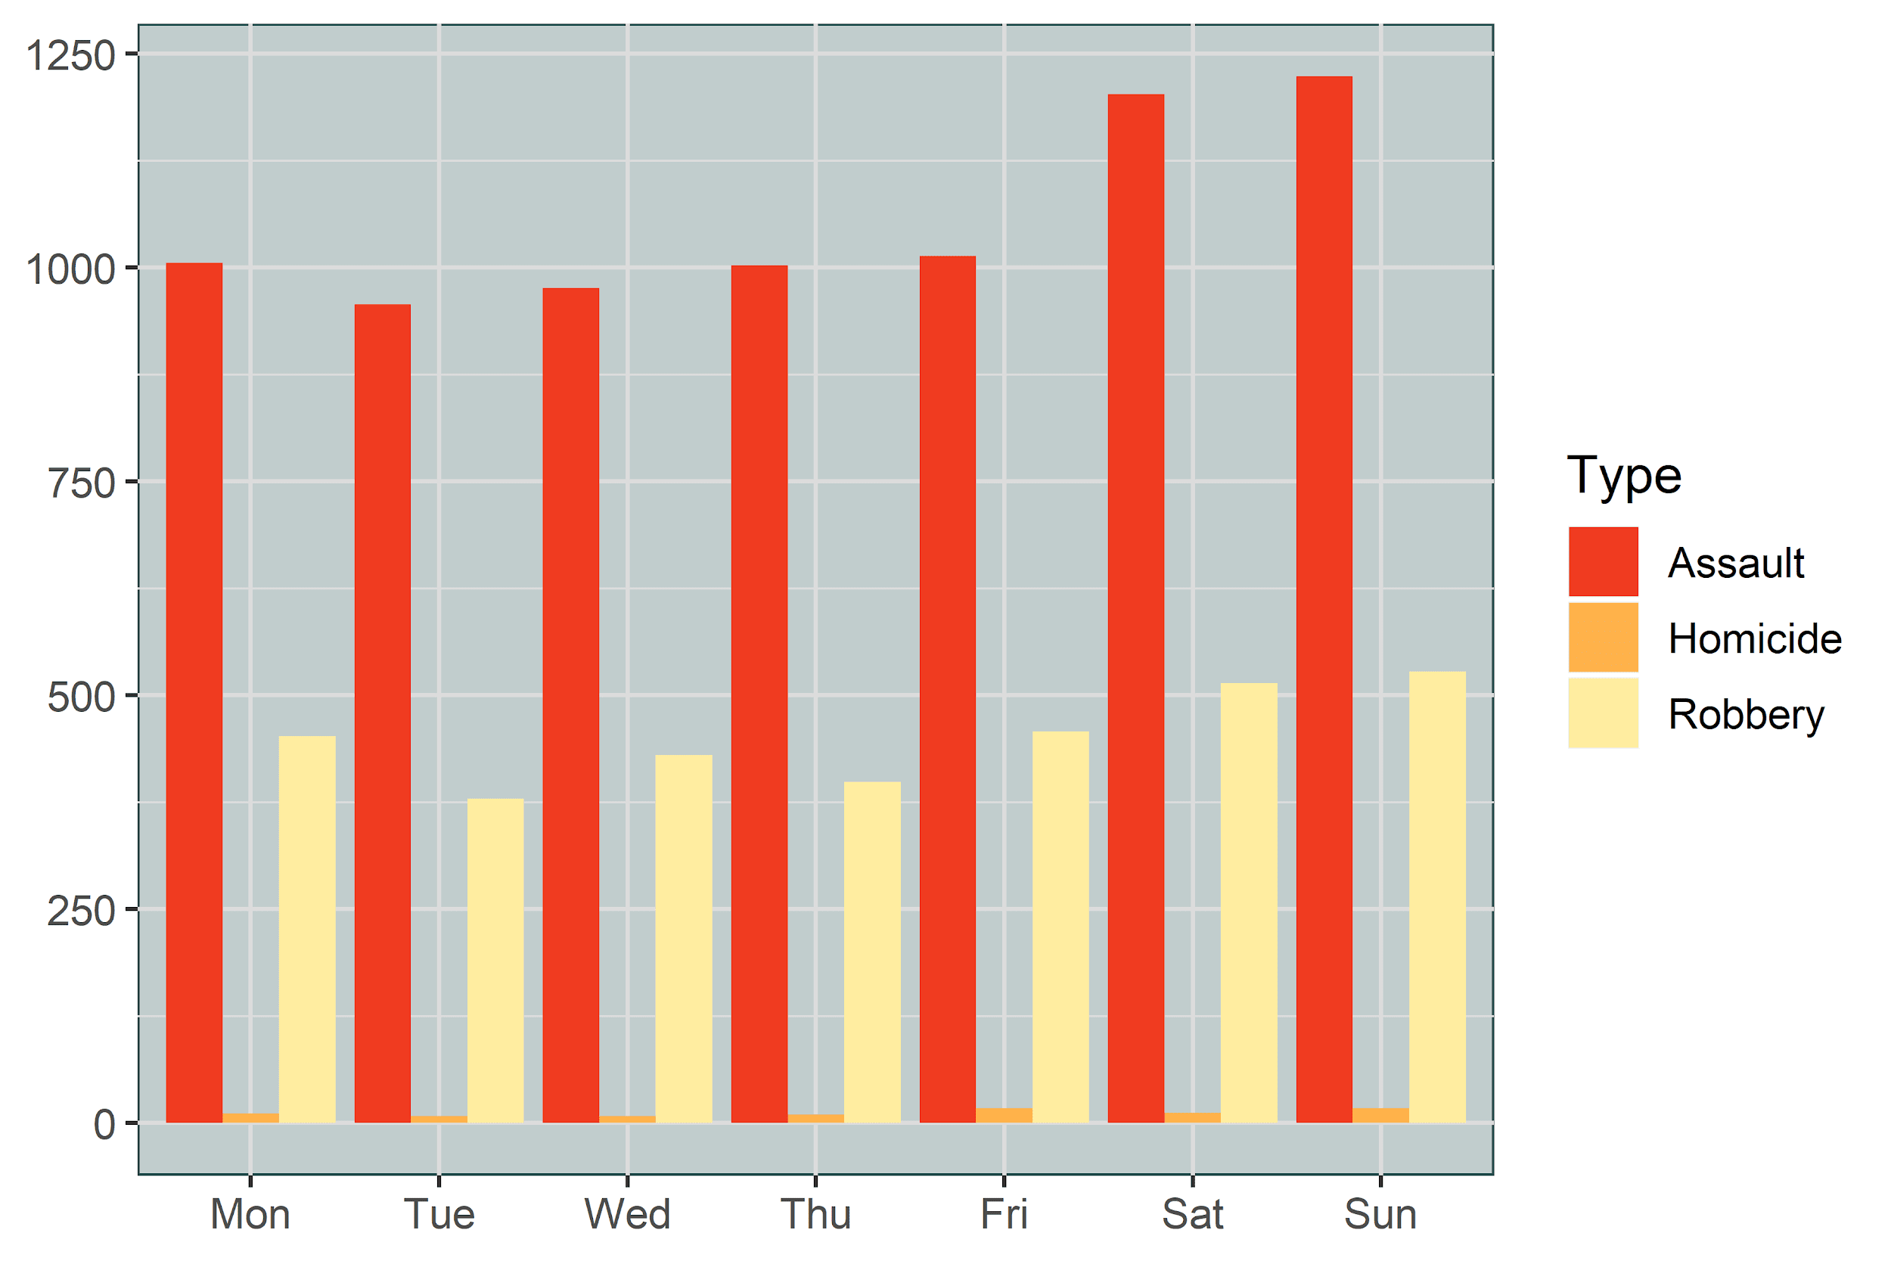
Violent Crime by Day of Week
Notes:
Fix x label - code fixed, retest
Remove y label - code fixed, retest
Remove x label
Rise and more crimes occur on the middle of the week. Counter intuitive to more going on in the weekend when there is more free time.

Slide 19
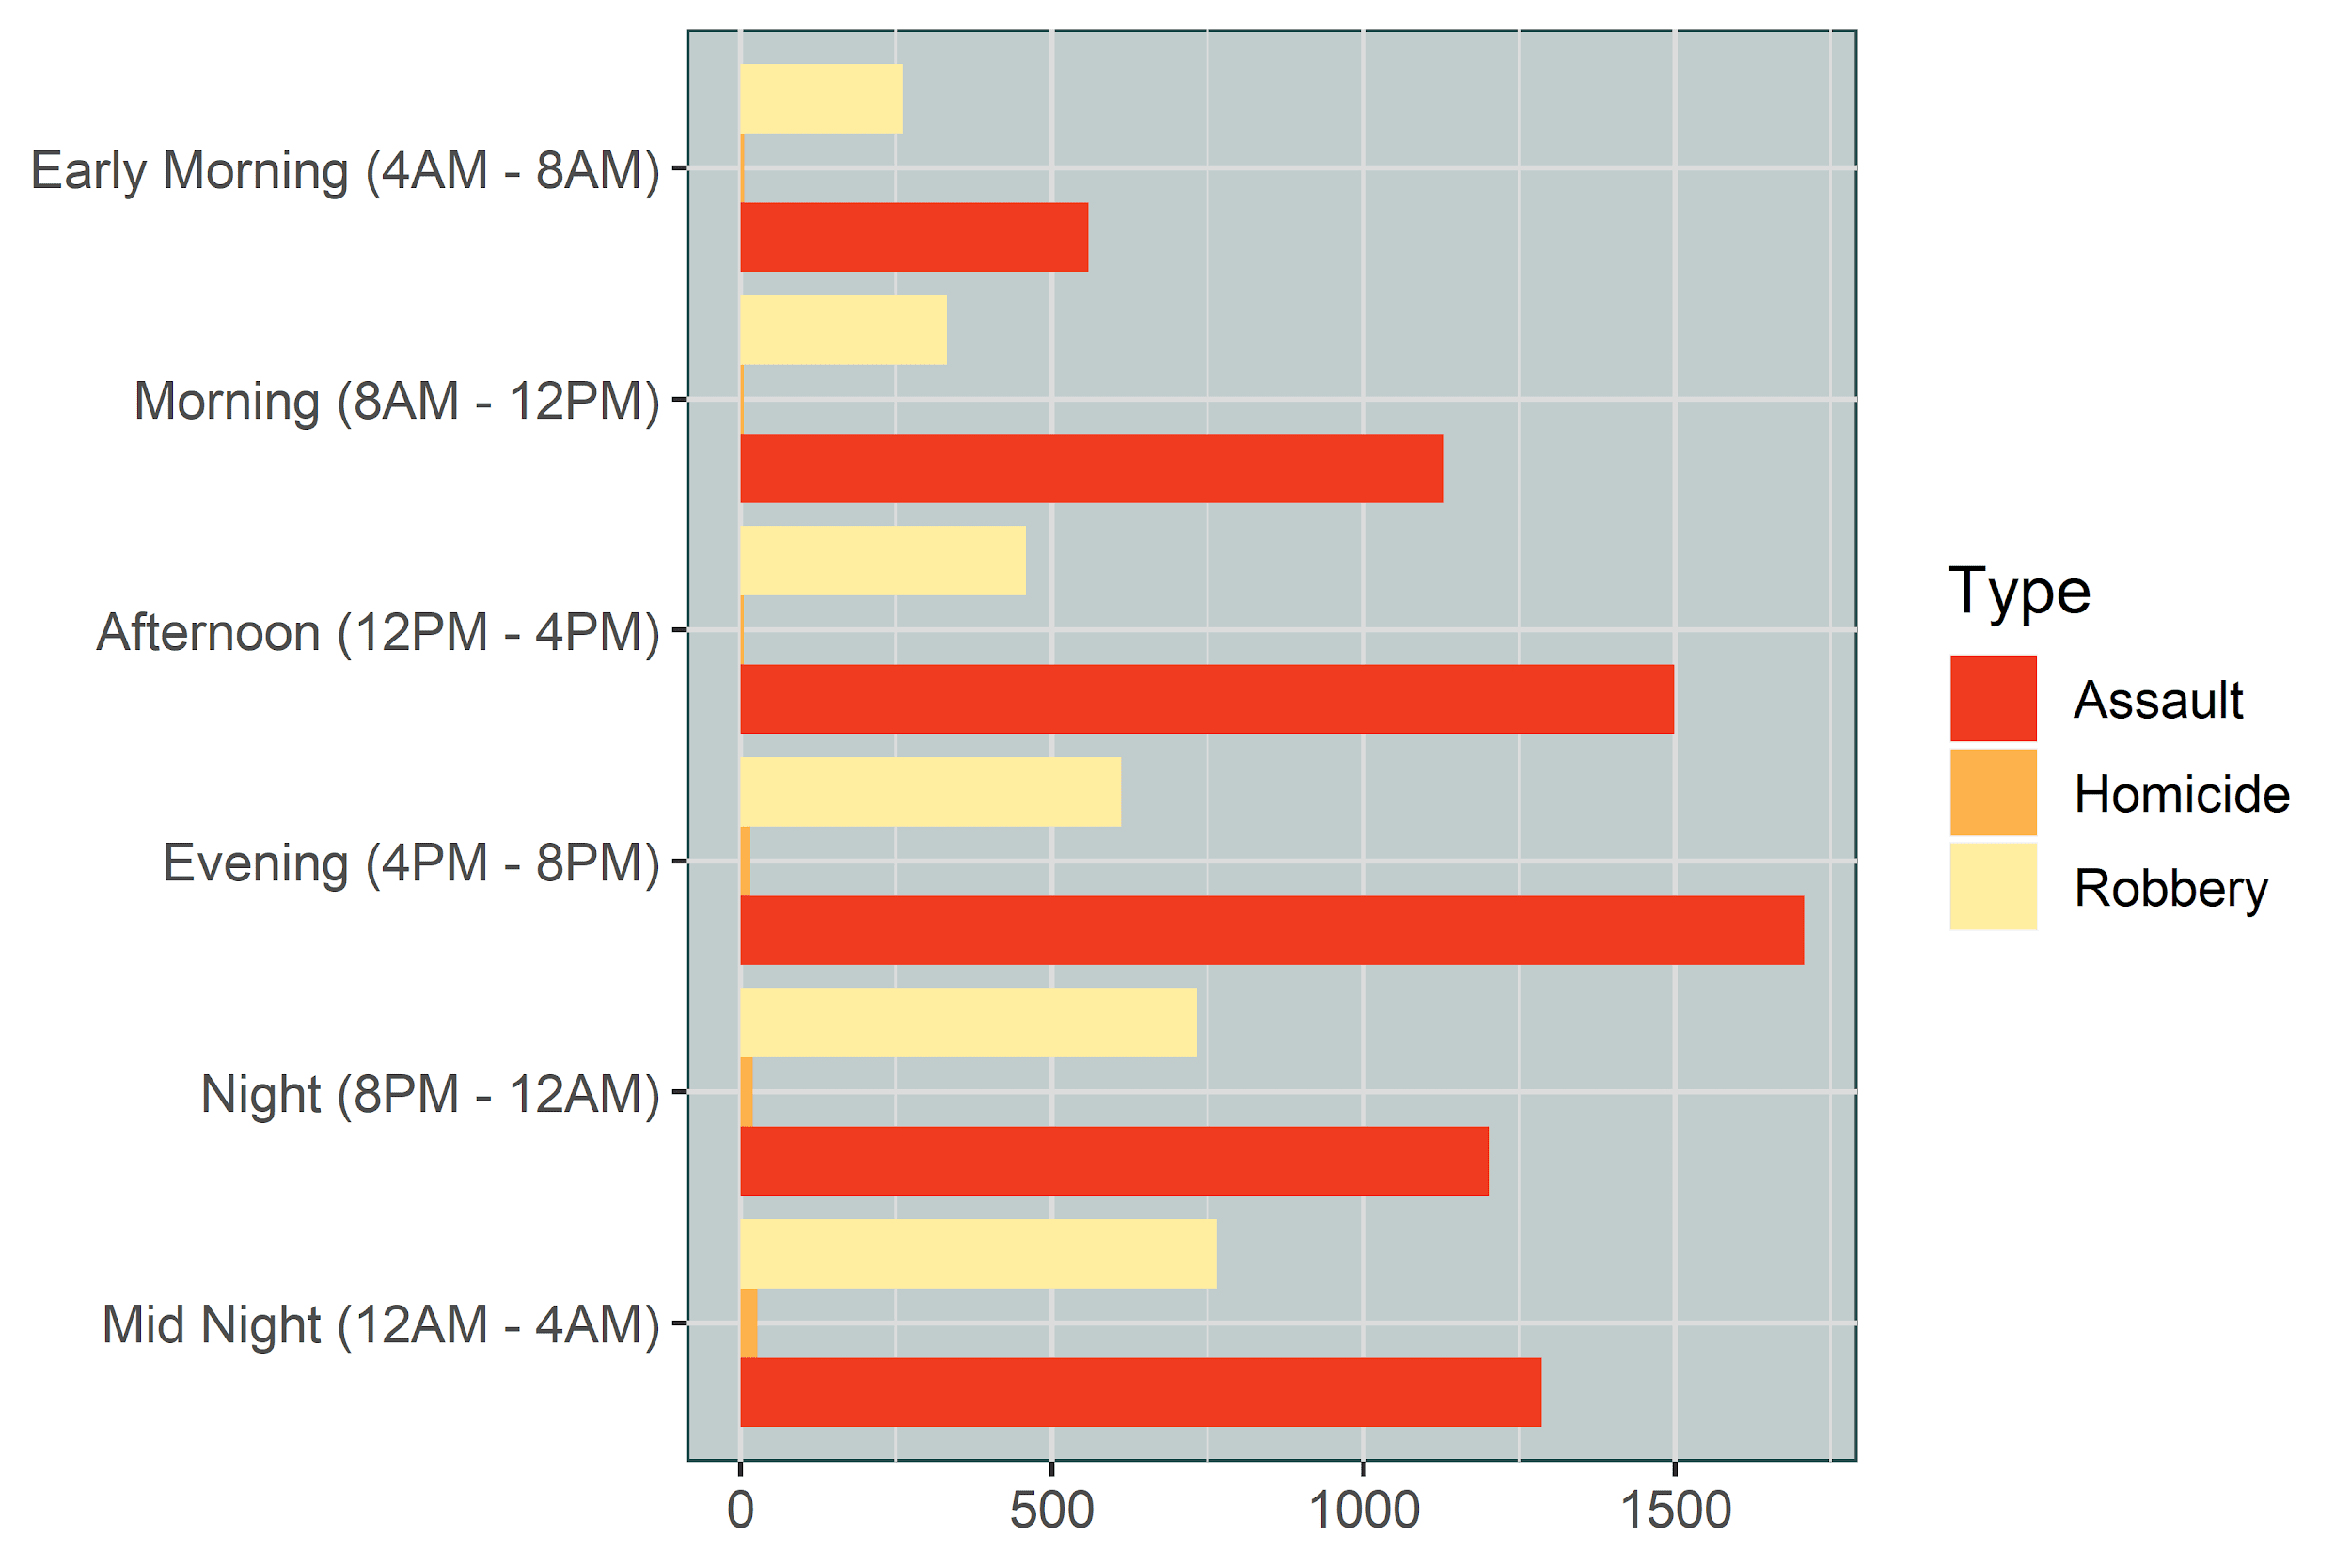
Violent Crime by Time of Day
Notes:
Remove x and y labels
Transition from crimes and types of crimes to police.

Slide 20
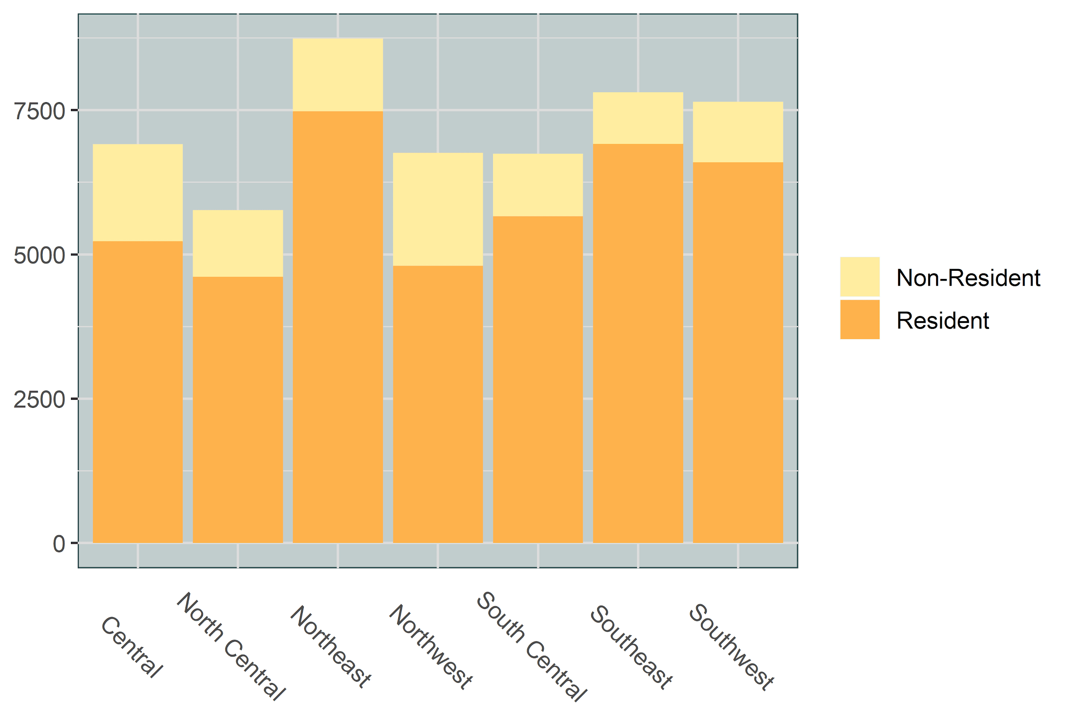

Victim Crime by Residency
Notes:
Fun fact: Northwest Dallas is home to the Dallas Cowboys Stadium and NHL Dallas Stars Stadium
Chart shows all crime
Correlation to non-resident(out of towners) victims, non-resident are disproportionate to residents in this area with the draw of entertainment of sporting events, etc

Slide 21
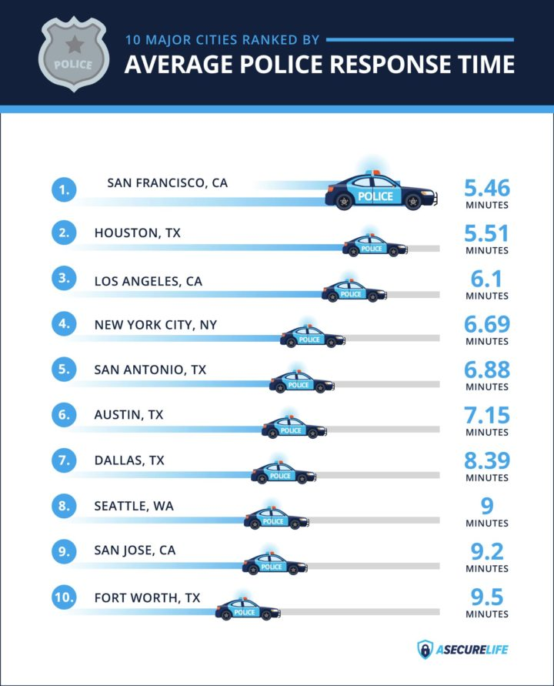
Response Time of Dallas Police
Time taken for the officer to arrive at the scene after a 911 call.
Differs from city to city based on factors like city population, police funding, and available resources.
It’s hard to give an accurate average when it comes to police response times.
Most cities aim to maintain an average response time of around five to six minutes for their highest-priority calls.
Rapidly growing cities simply outpace police department’s ability to scale their resources.

Slide 22
Response Time of Dallas Police
Time between Call Received Time and Call Dispatch Time.
Using the “median” response time as opposed to “mean” as it skews the data.
The Speed of response time is a quantile within the aggregated dataset (Fastest, Fast, Slow and Slowest).
The average response time of Dallas Police is

Slide 23
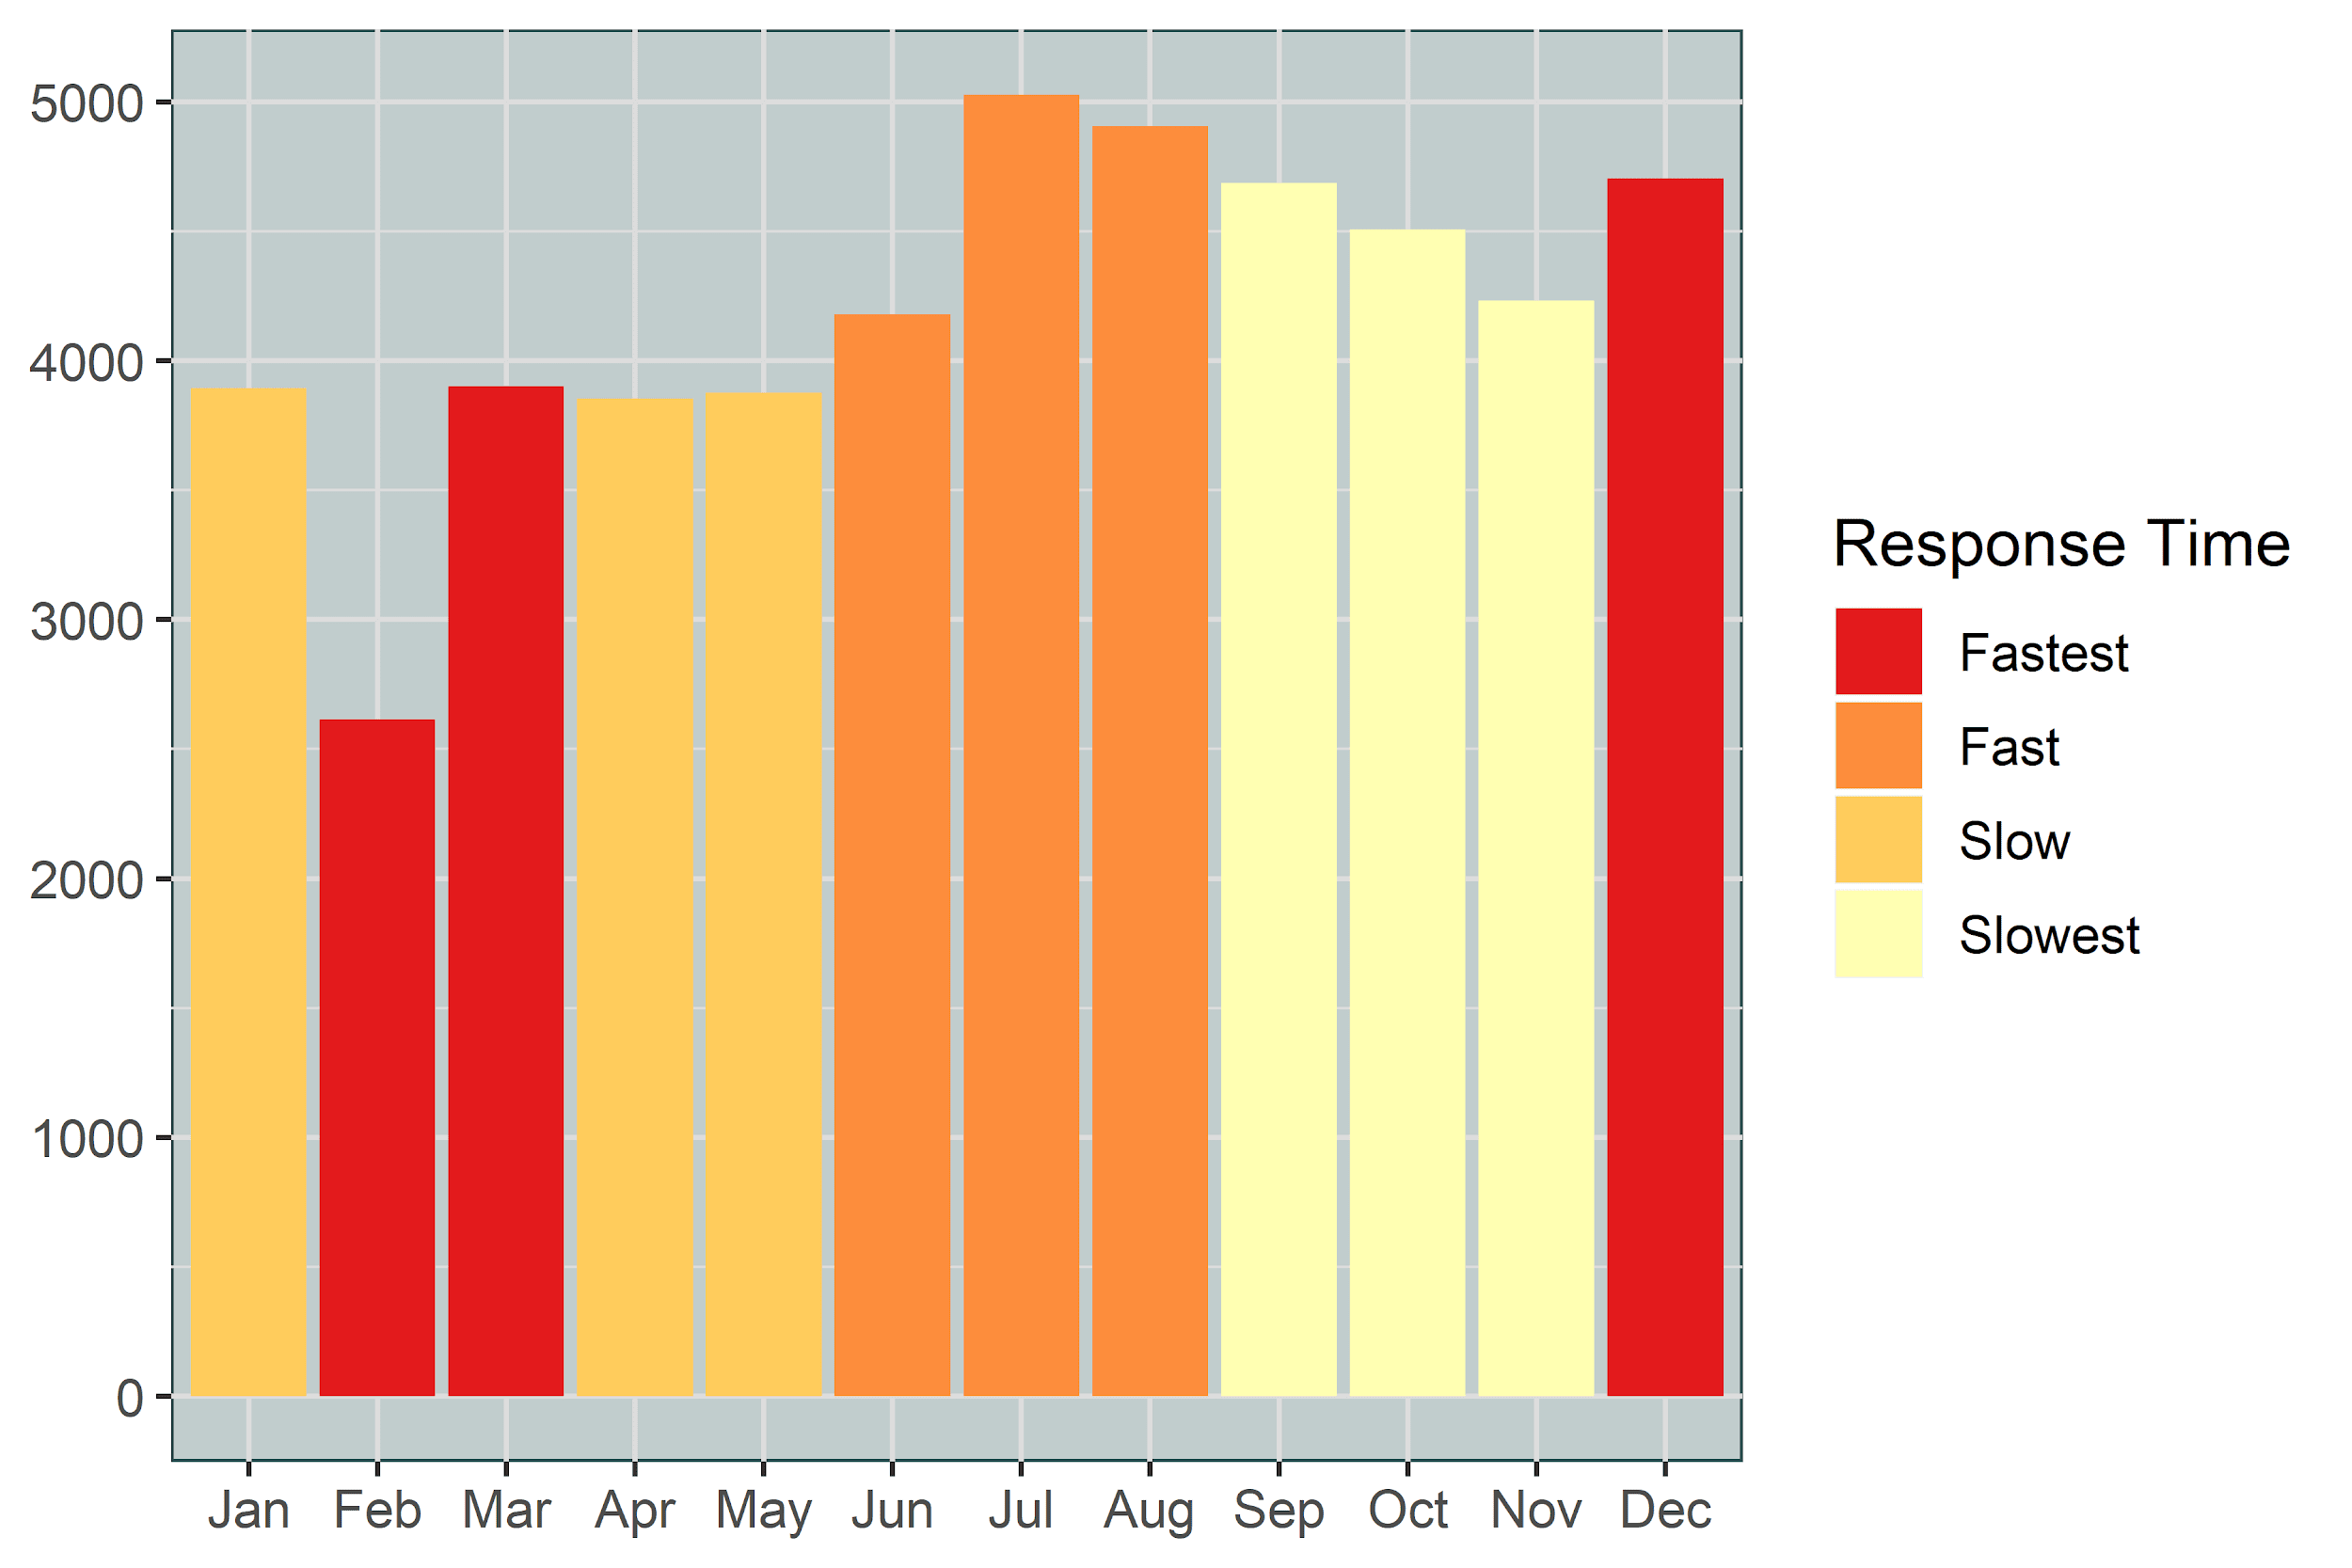
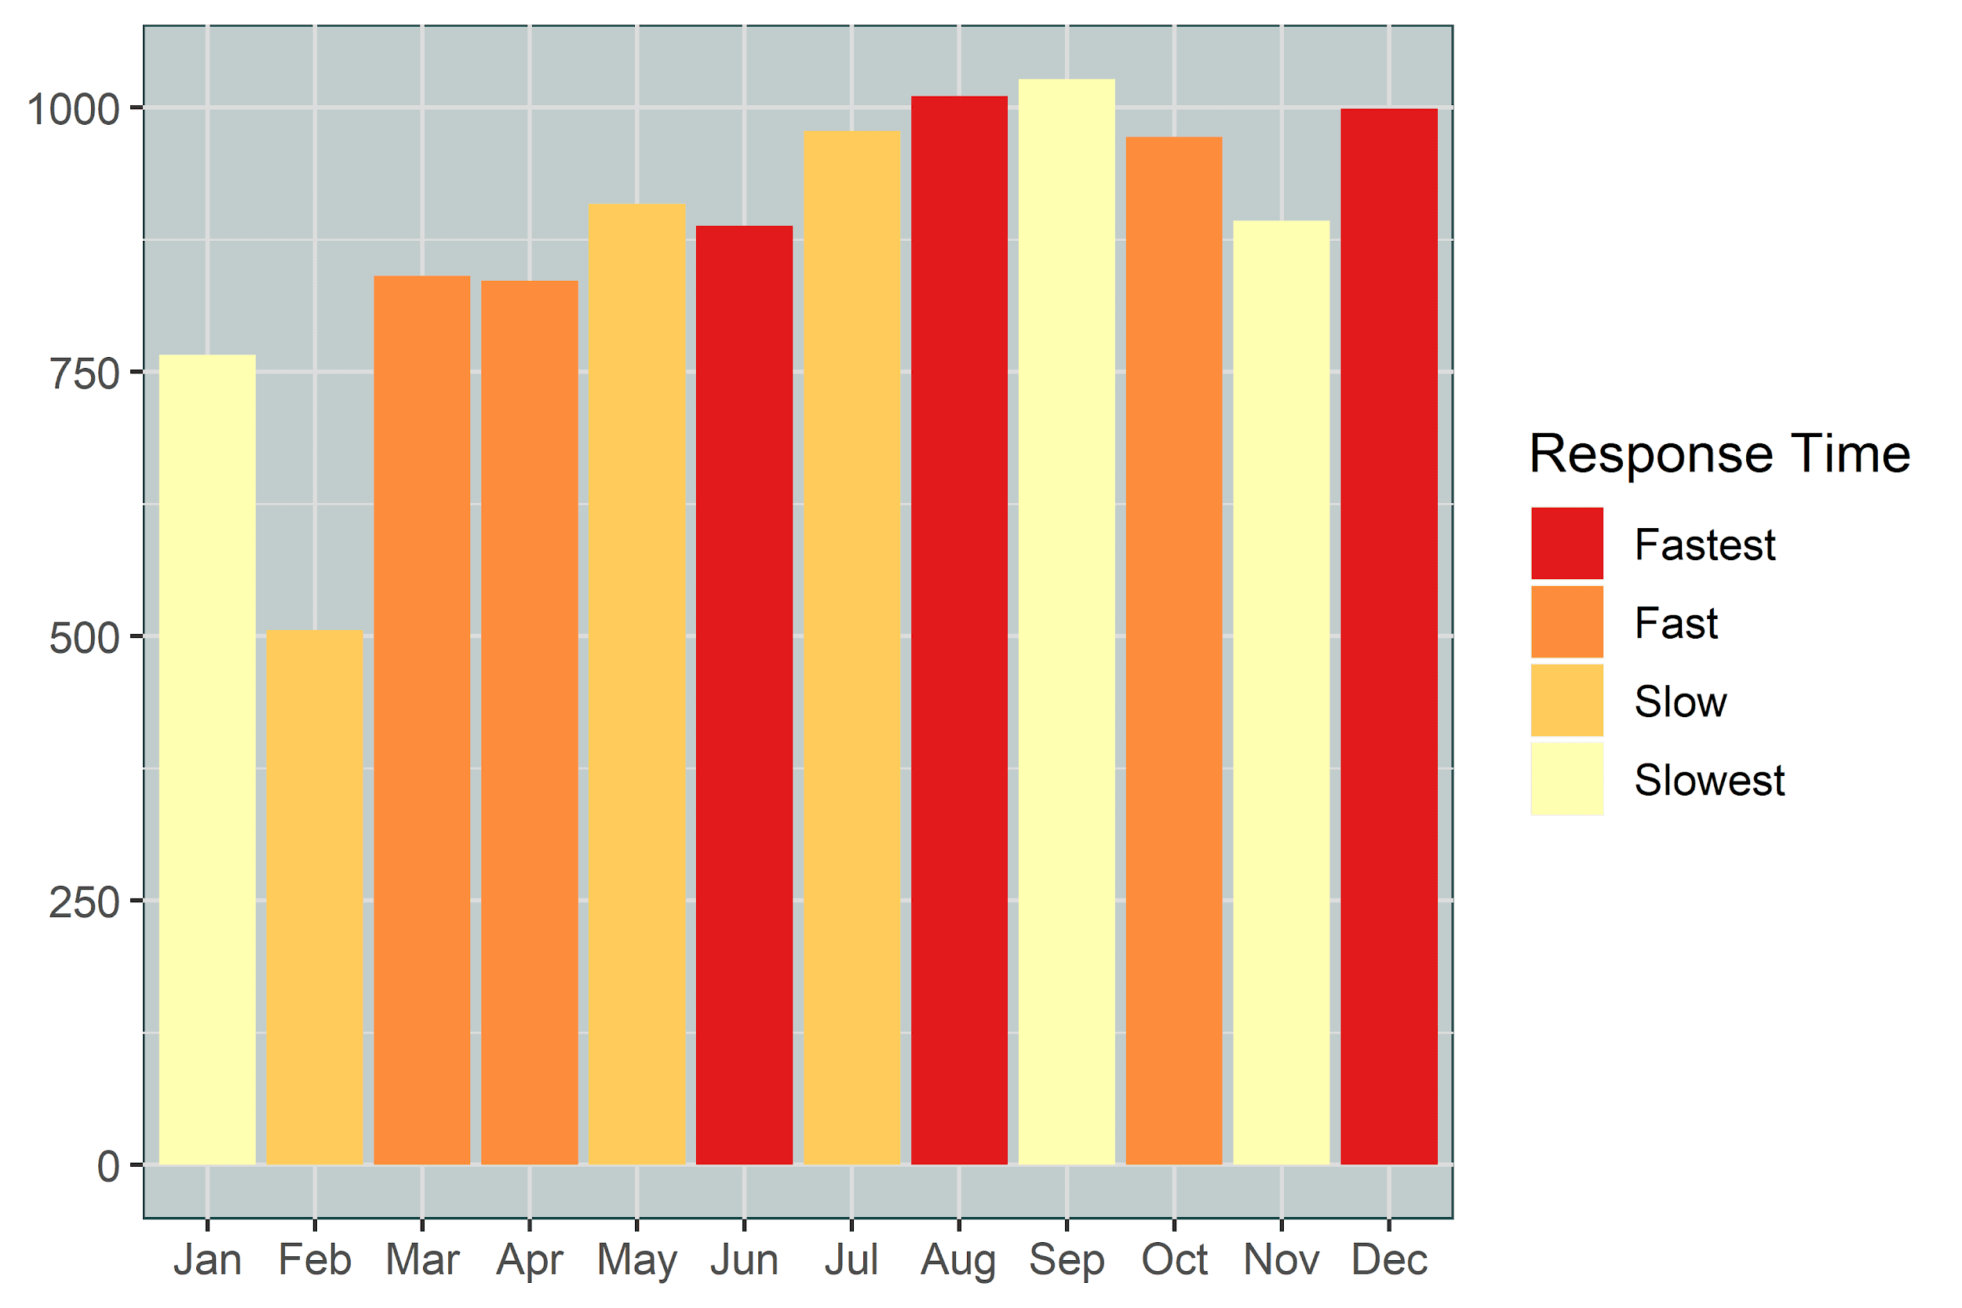
Responsiveness by Month
All Crimes
Violent Crimes
Notes:
Comparison of Response Time (All vs Violent)
All Crimes chart – Fast during Summer months and slowed down in Winter.
It is evident that Most responsive month is December
Violent
Aug/Dec were most responsive for Violent Crimes
Pretty much they stayed active during all month here.

Slide 24
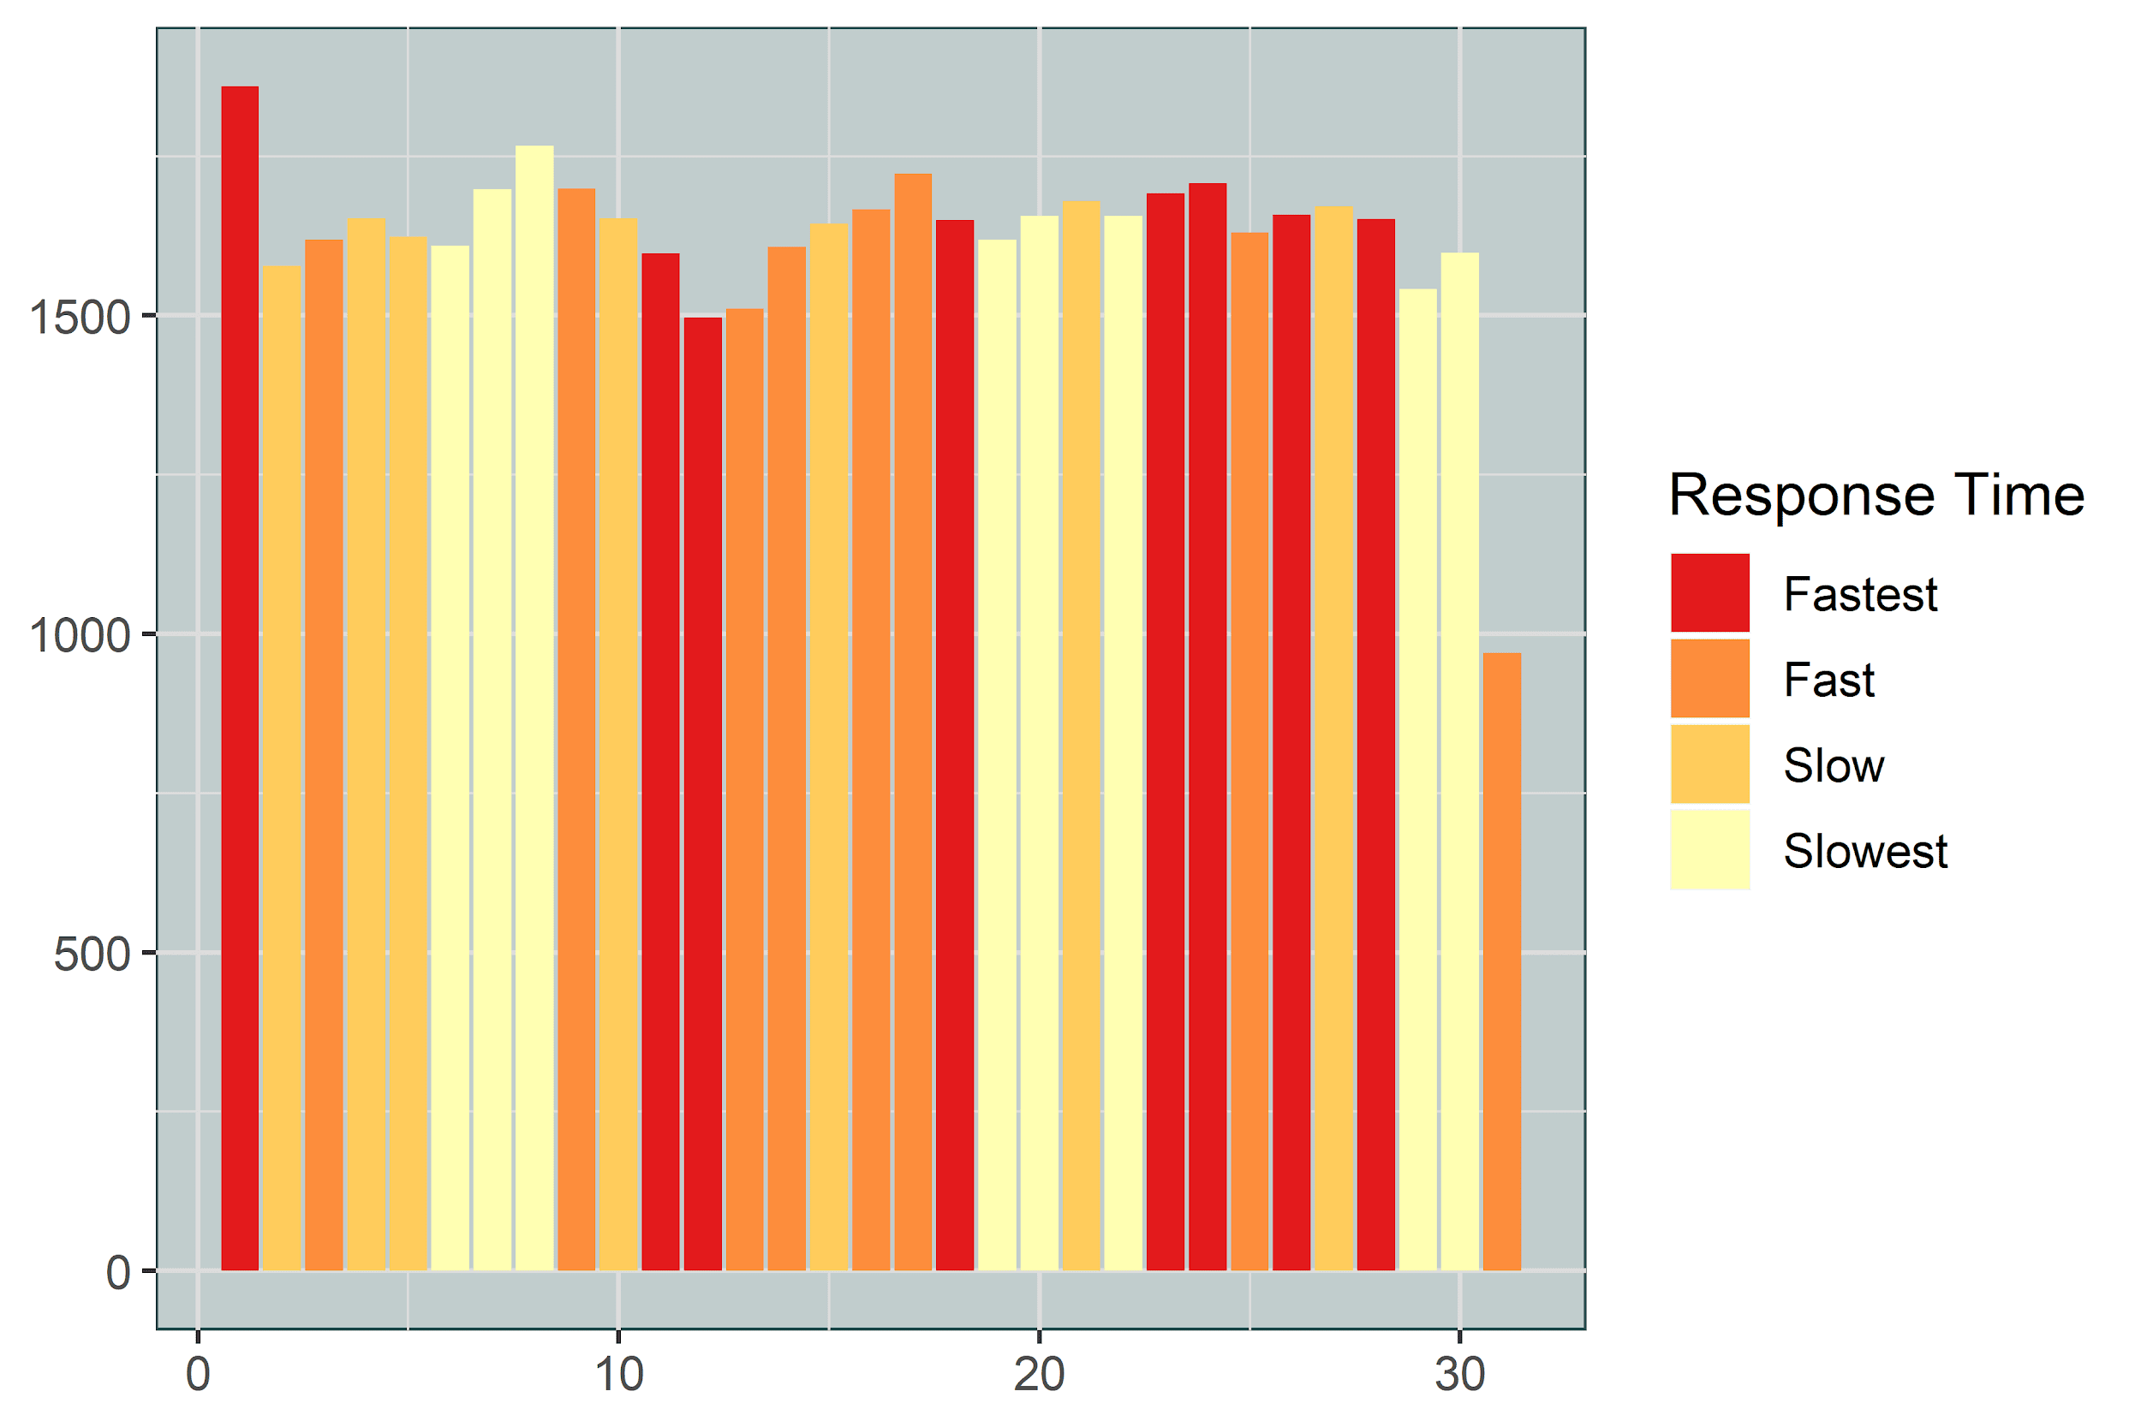
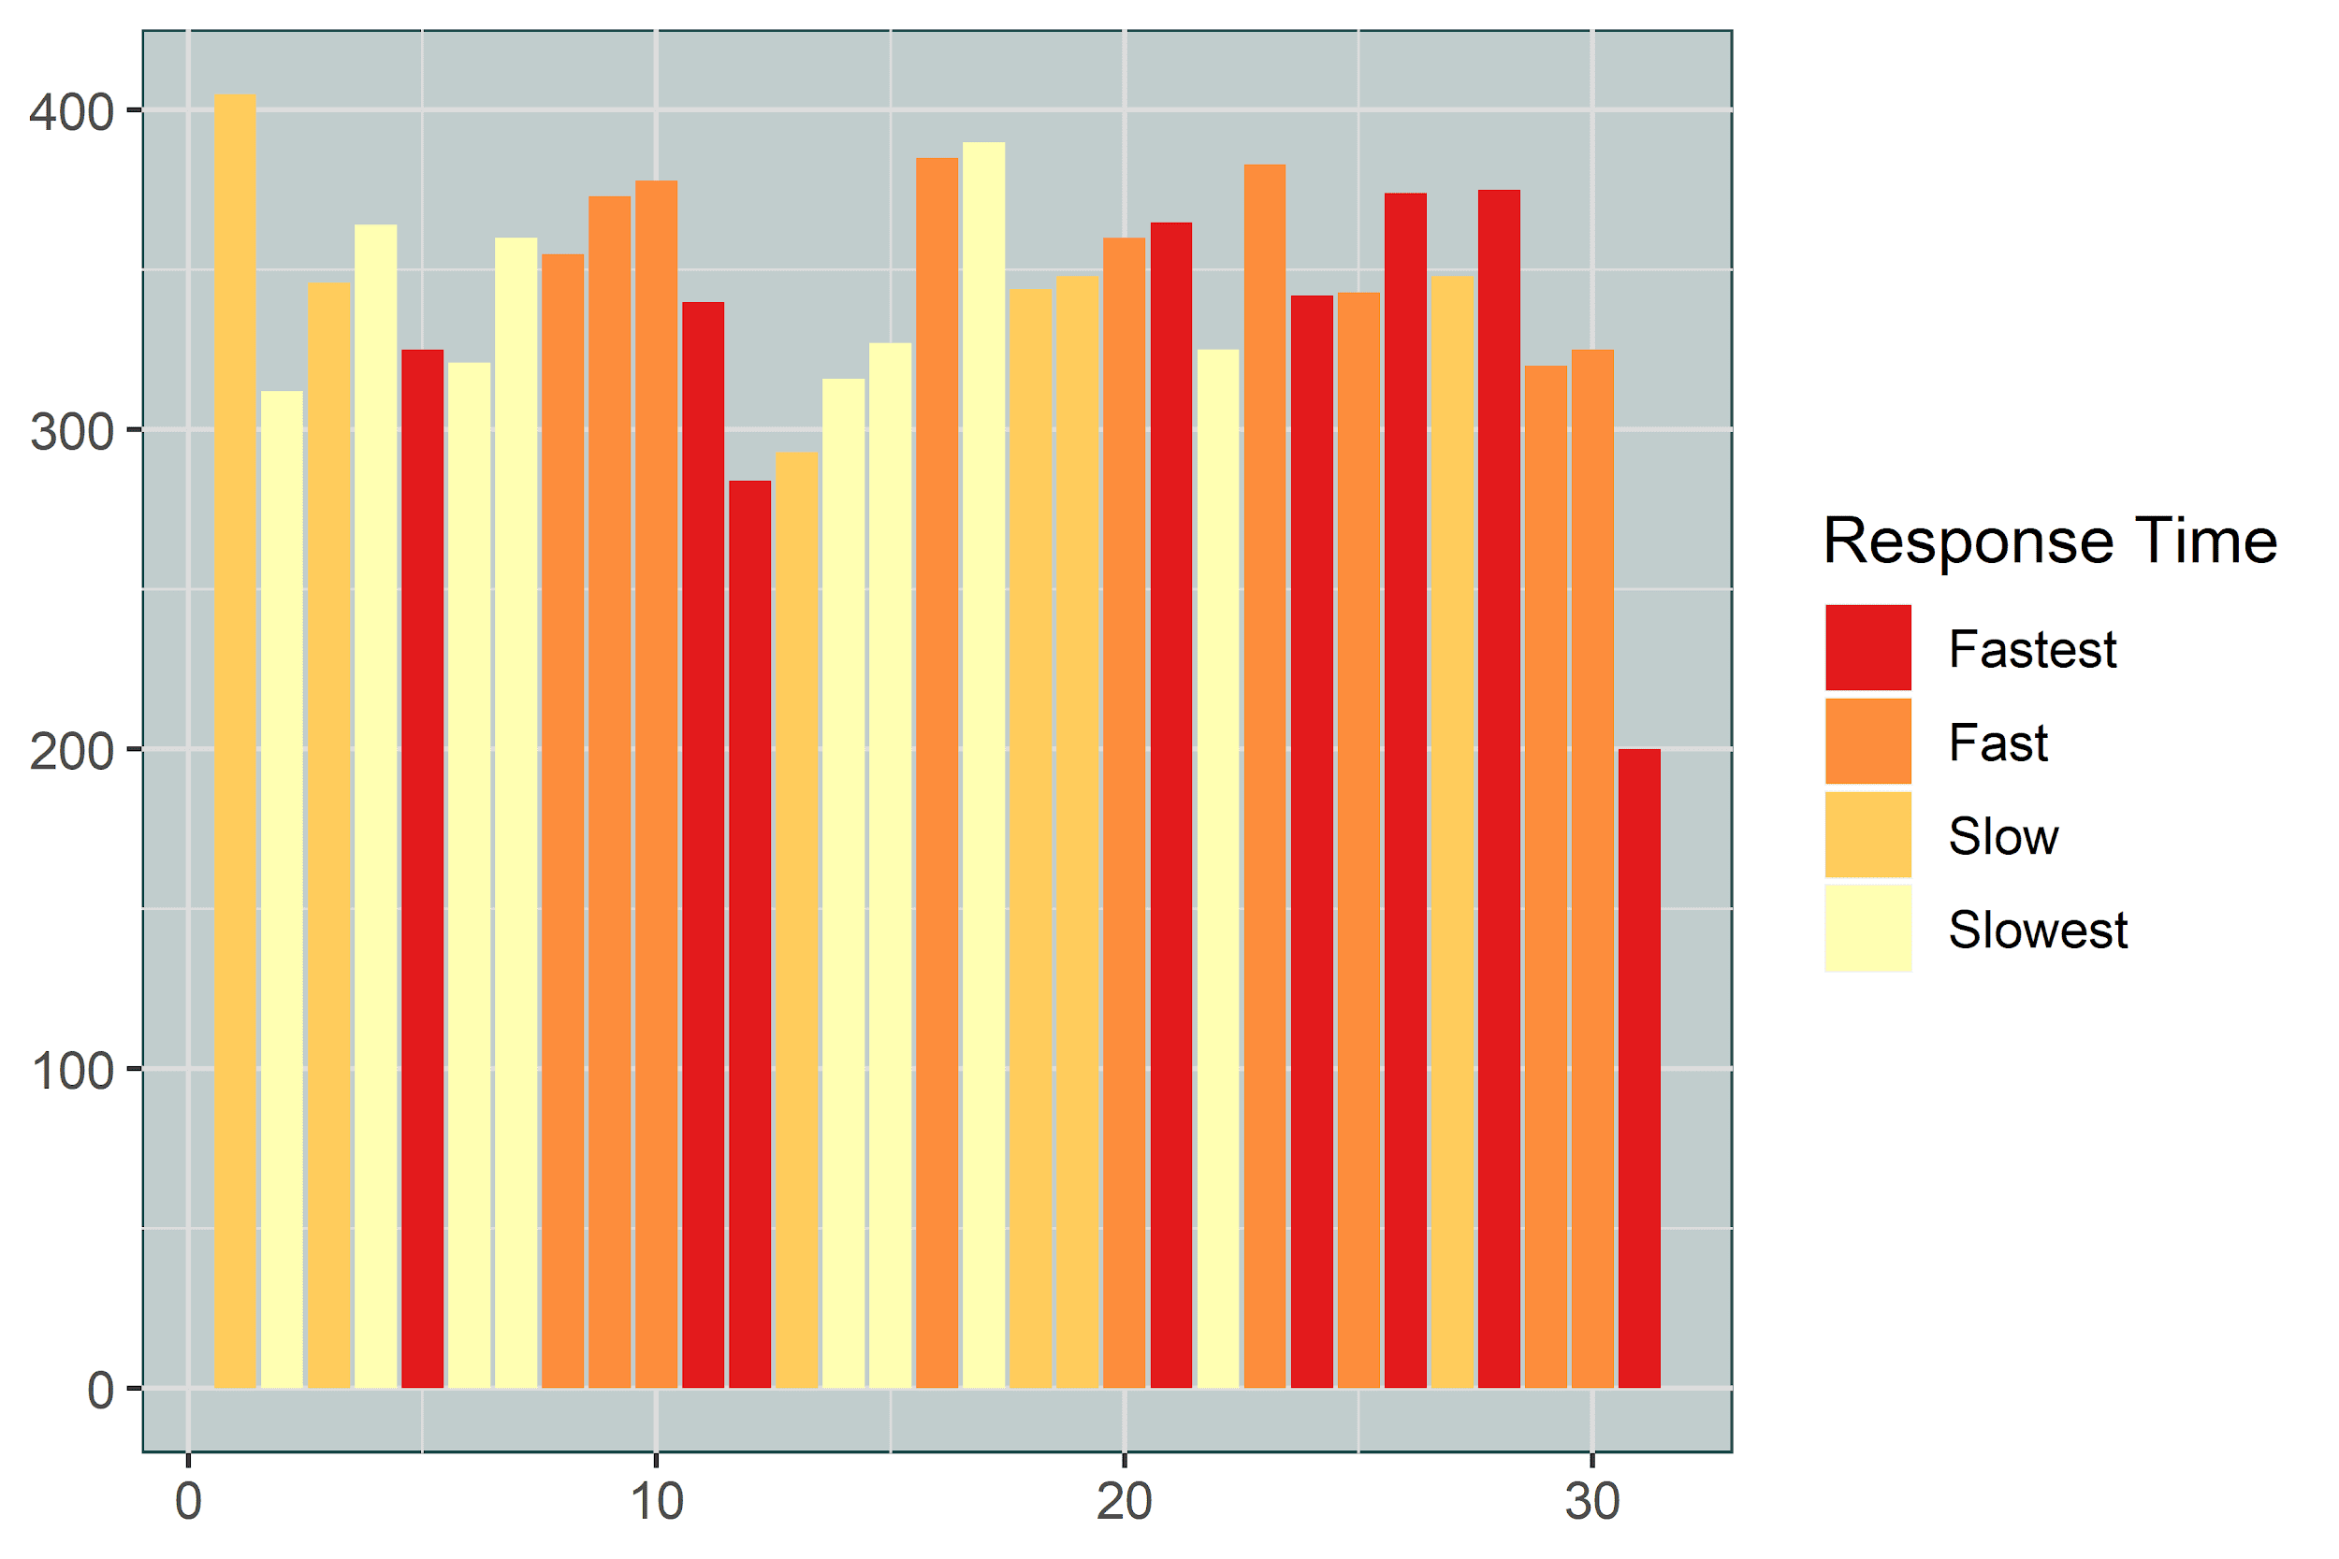
Which day of Month were they most responsive?
All Crimes
Violent Crimes
Notes:
Overall
Most responsive on the first day and active during the end of the month.
Stayed very active during the second and third week.
Violent
Slow on the first day.
Started slow and were consistently active in the last 15 days.

Slide 25
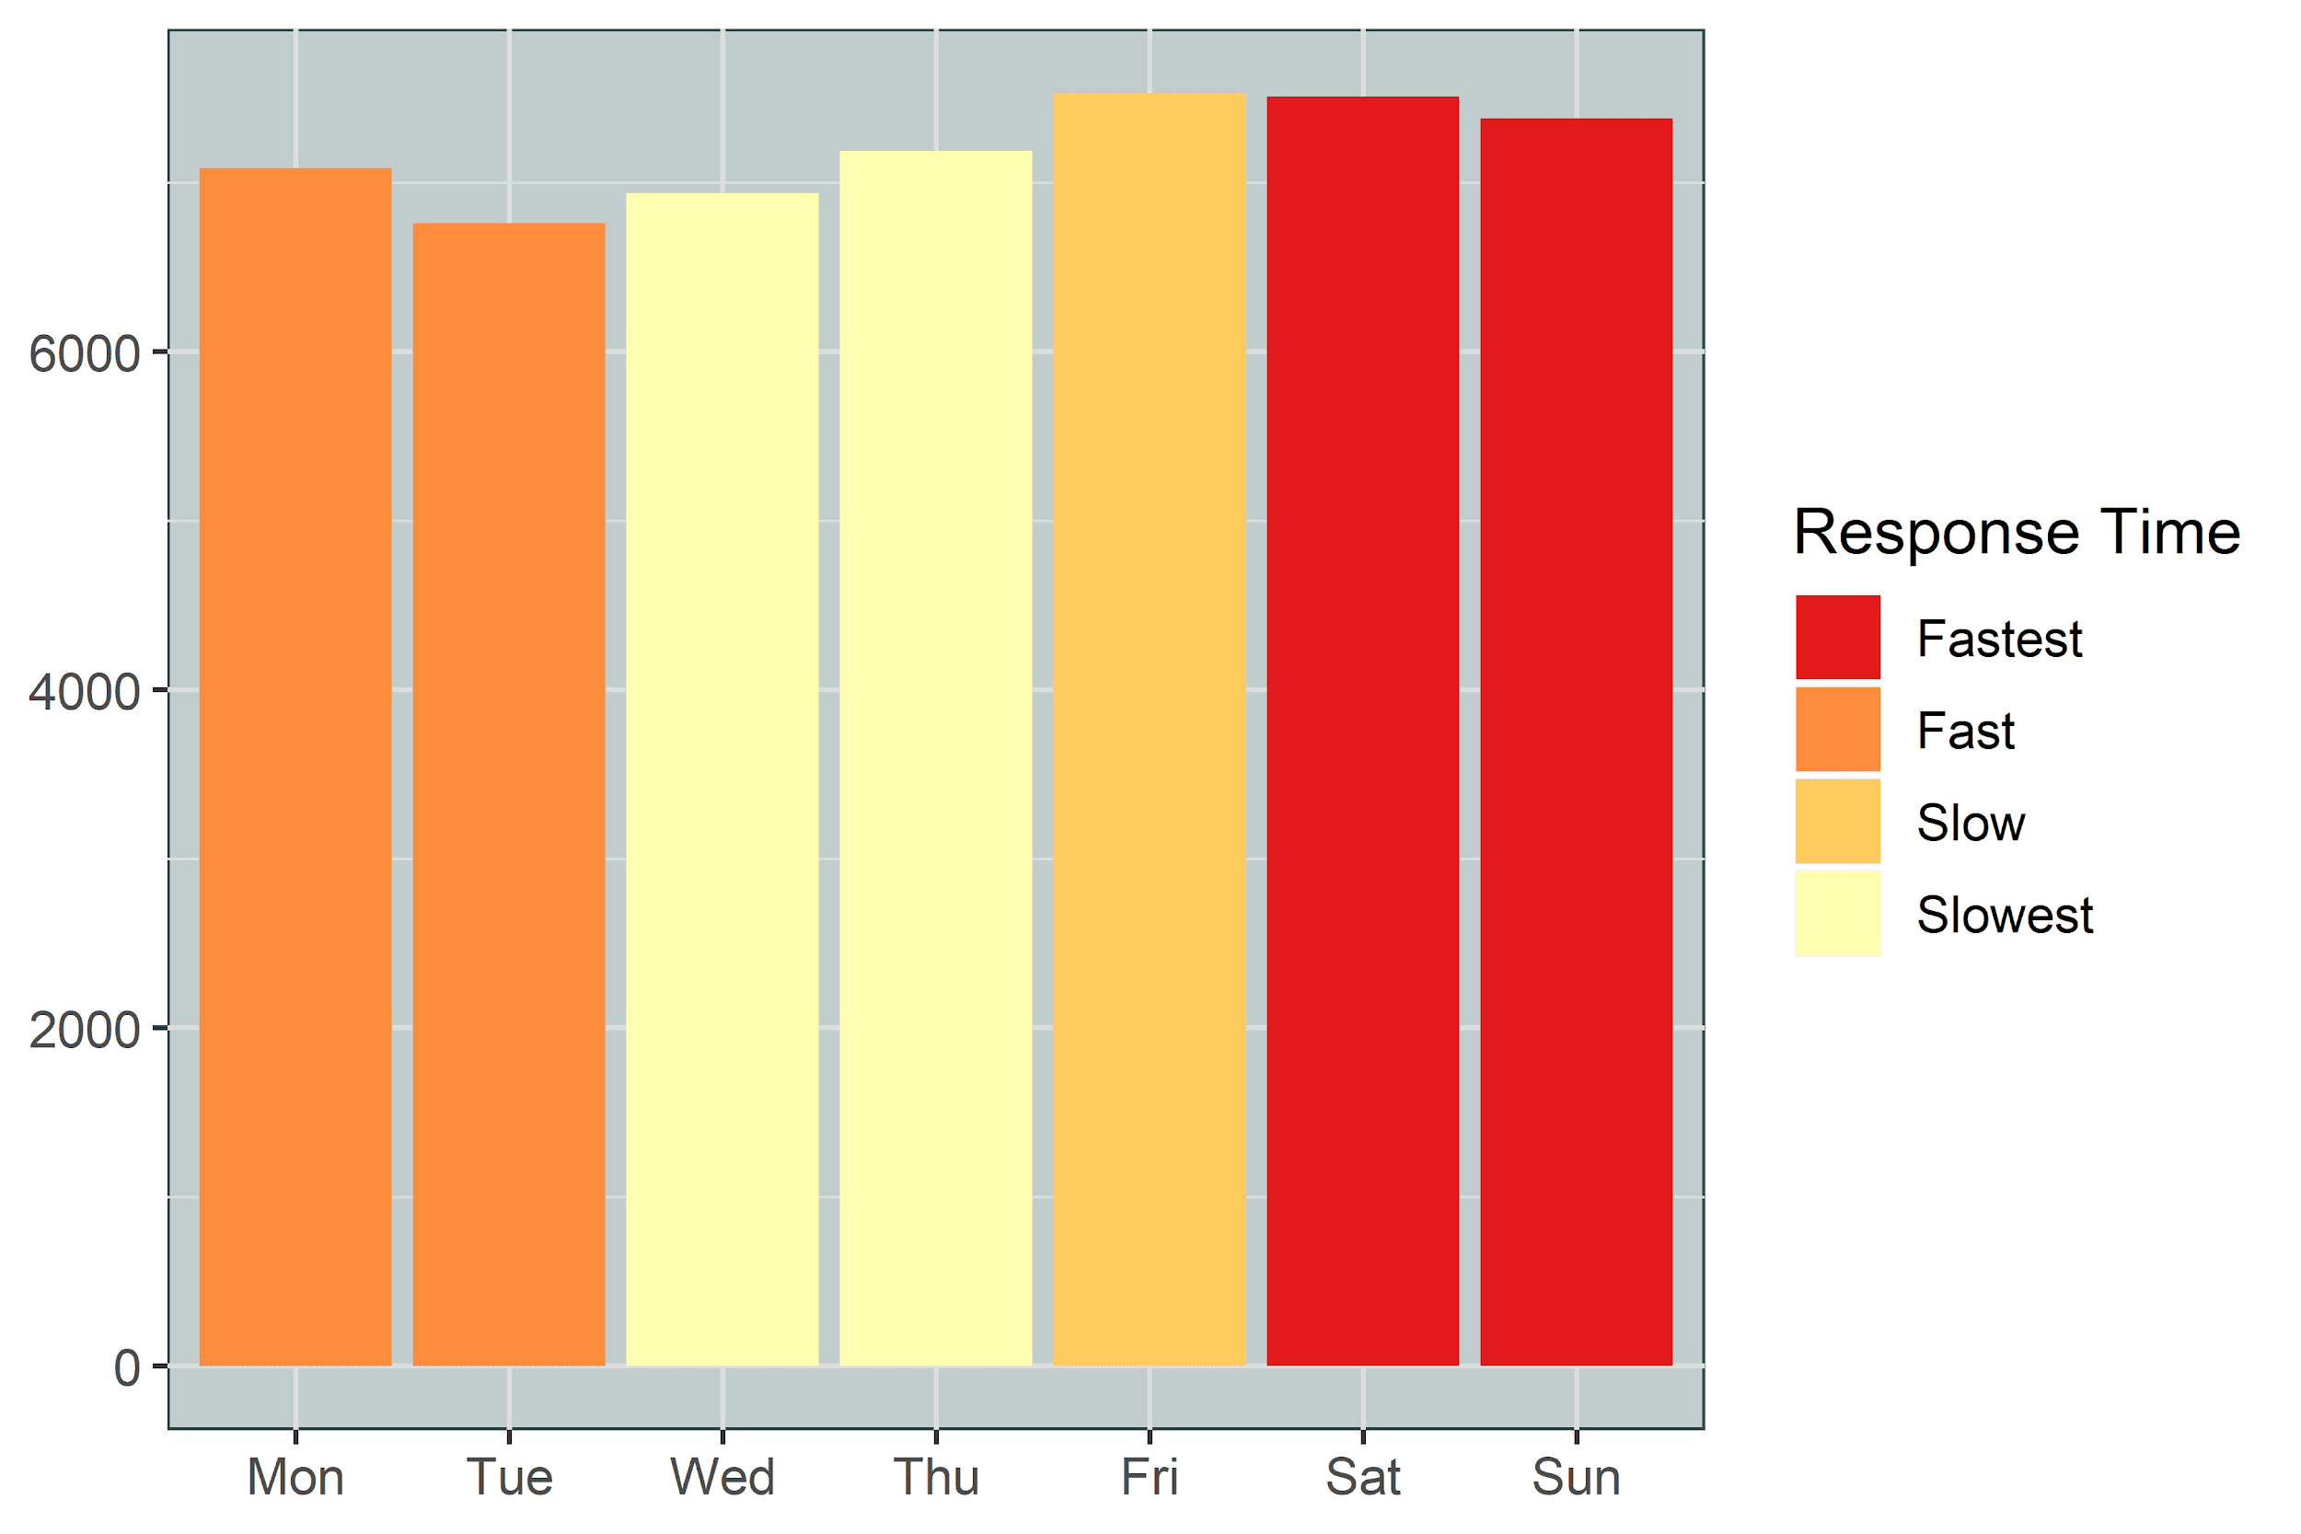
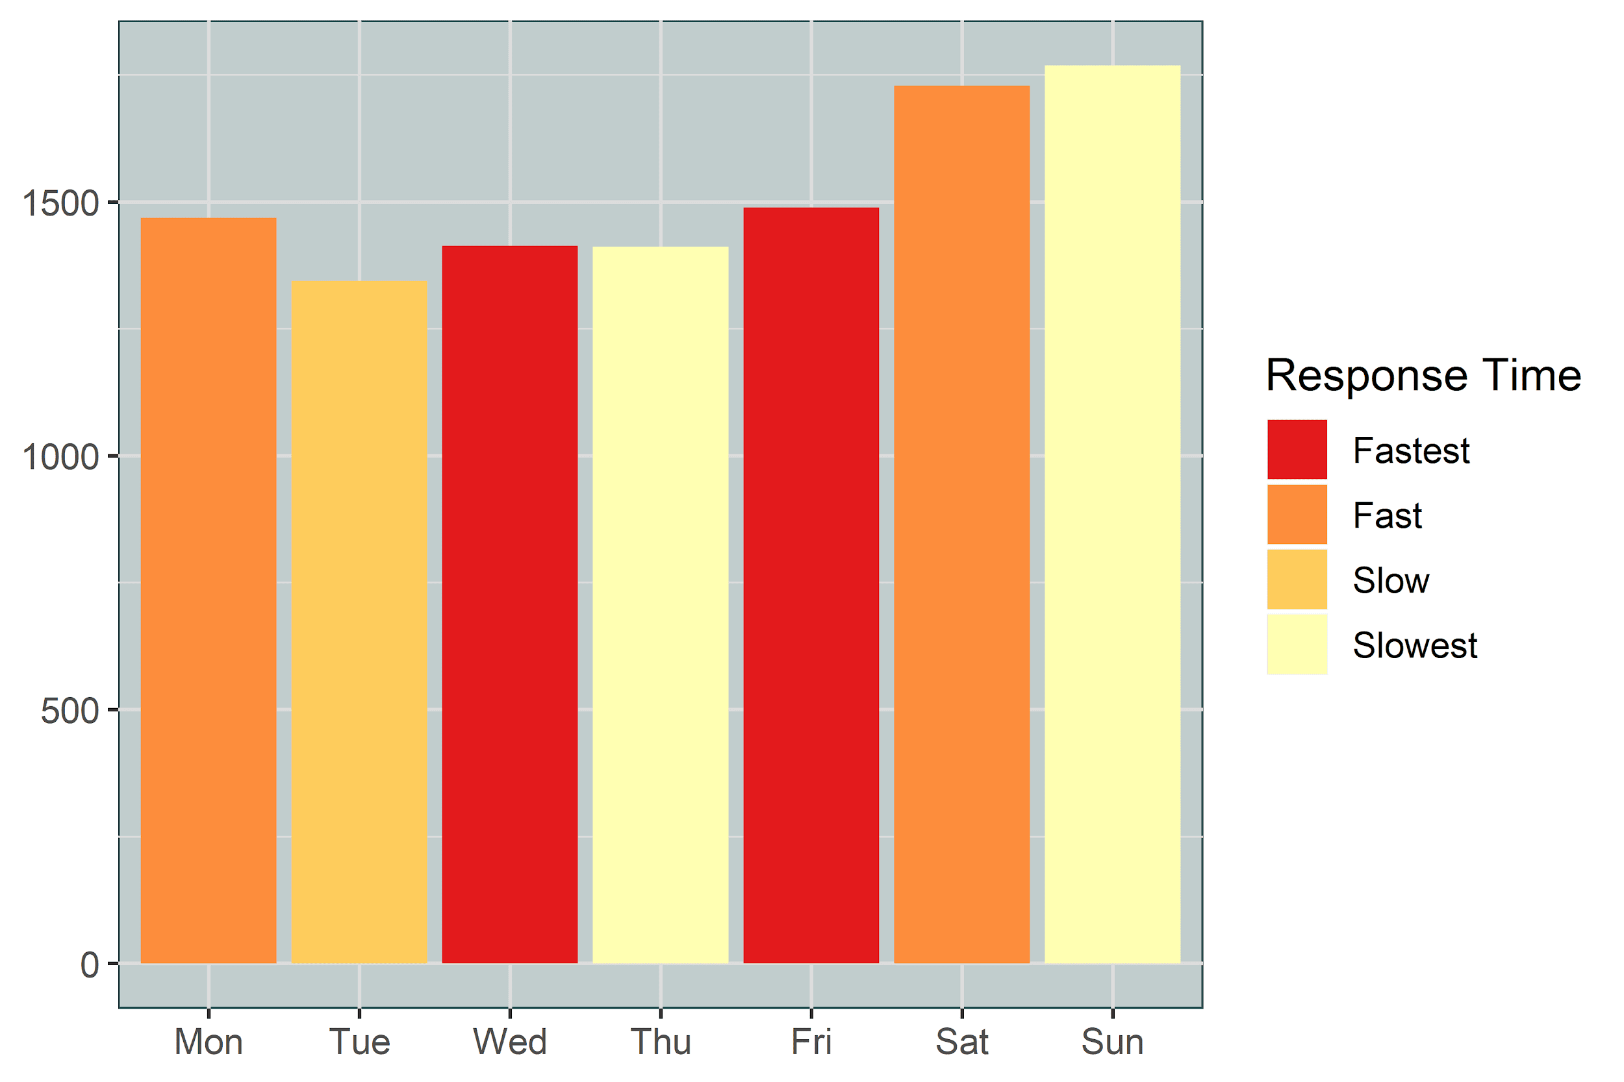
Which day turns out most responsive?
All Crimes
Violent Crimes
Notes:
Overall
Weekend is when most crimes occur during which they were responsive which is good.
One thing to note they were fast during Week start and slowed in mid of the week.
Violent
On the contrary, the response is the slowest on Sunday.
But mostly consistent throughout the week.

Slide 26
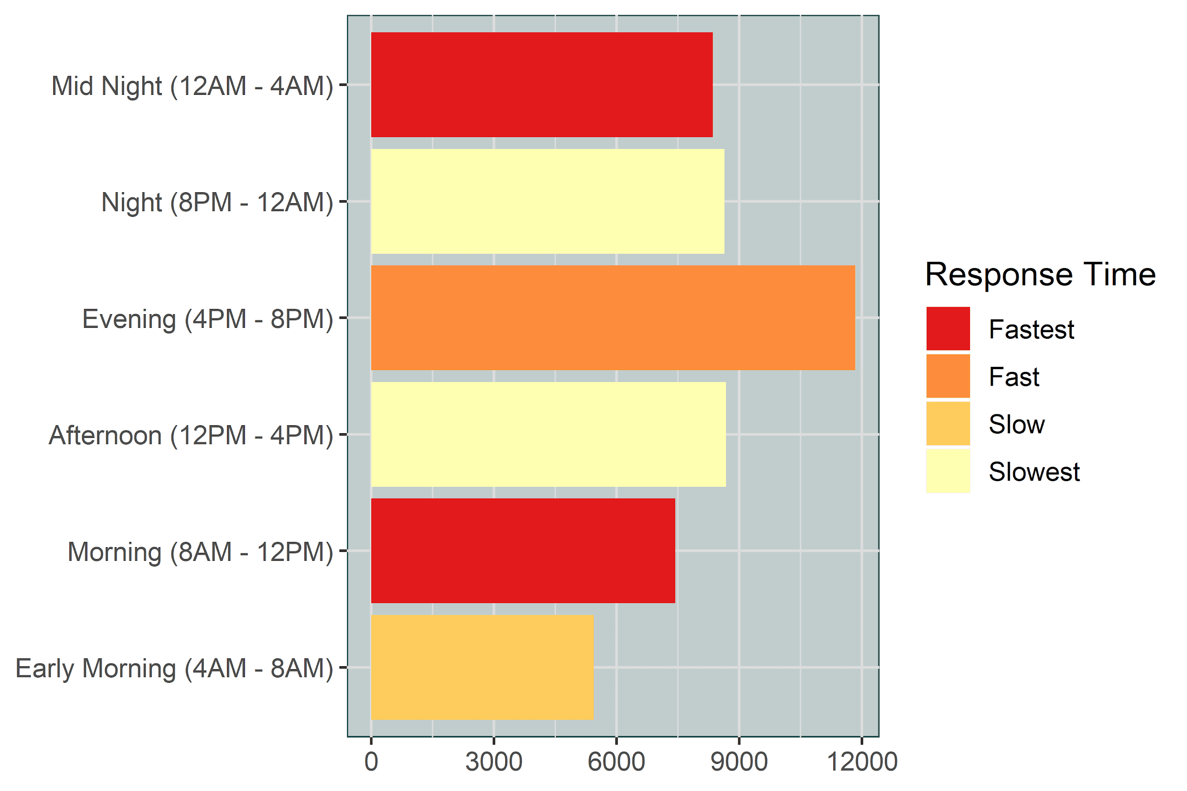
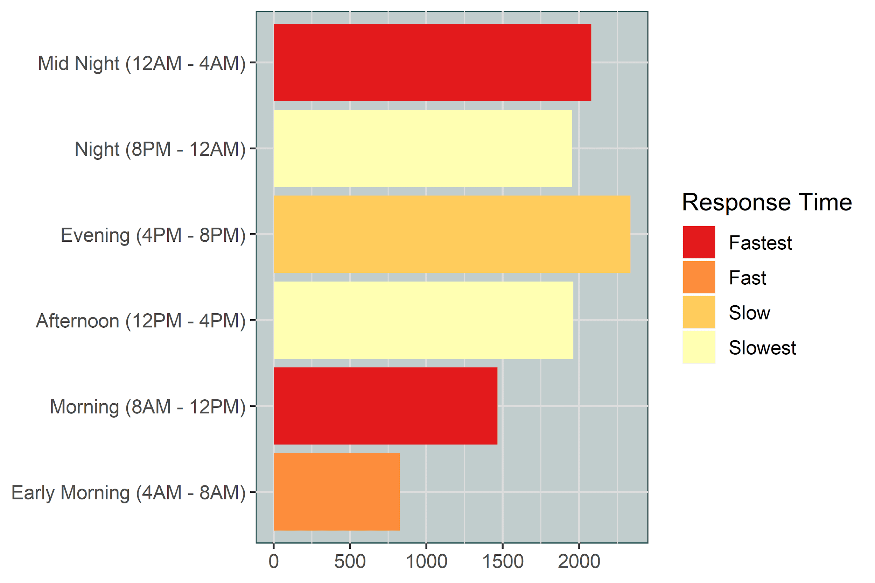
What time are they most responsive?
All Crimes
Violent Crimes
Notes:
Overall
Evening is when the most crimes occur and the response is Fast.
Violent
For violent crimes, they were Slow.
Able to provide Fastest response during Mid night, it may due to light traffic during that time.
Afternoon is the Slowest, which is again may be to peak traffic.

Slide 27
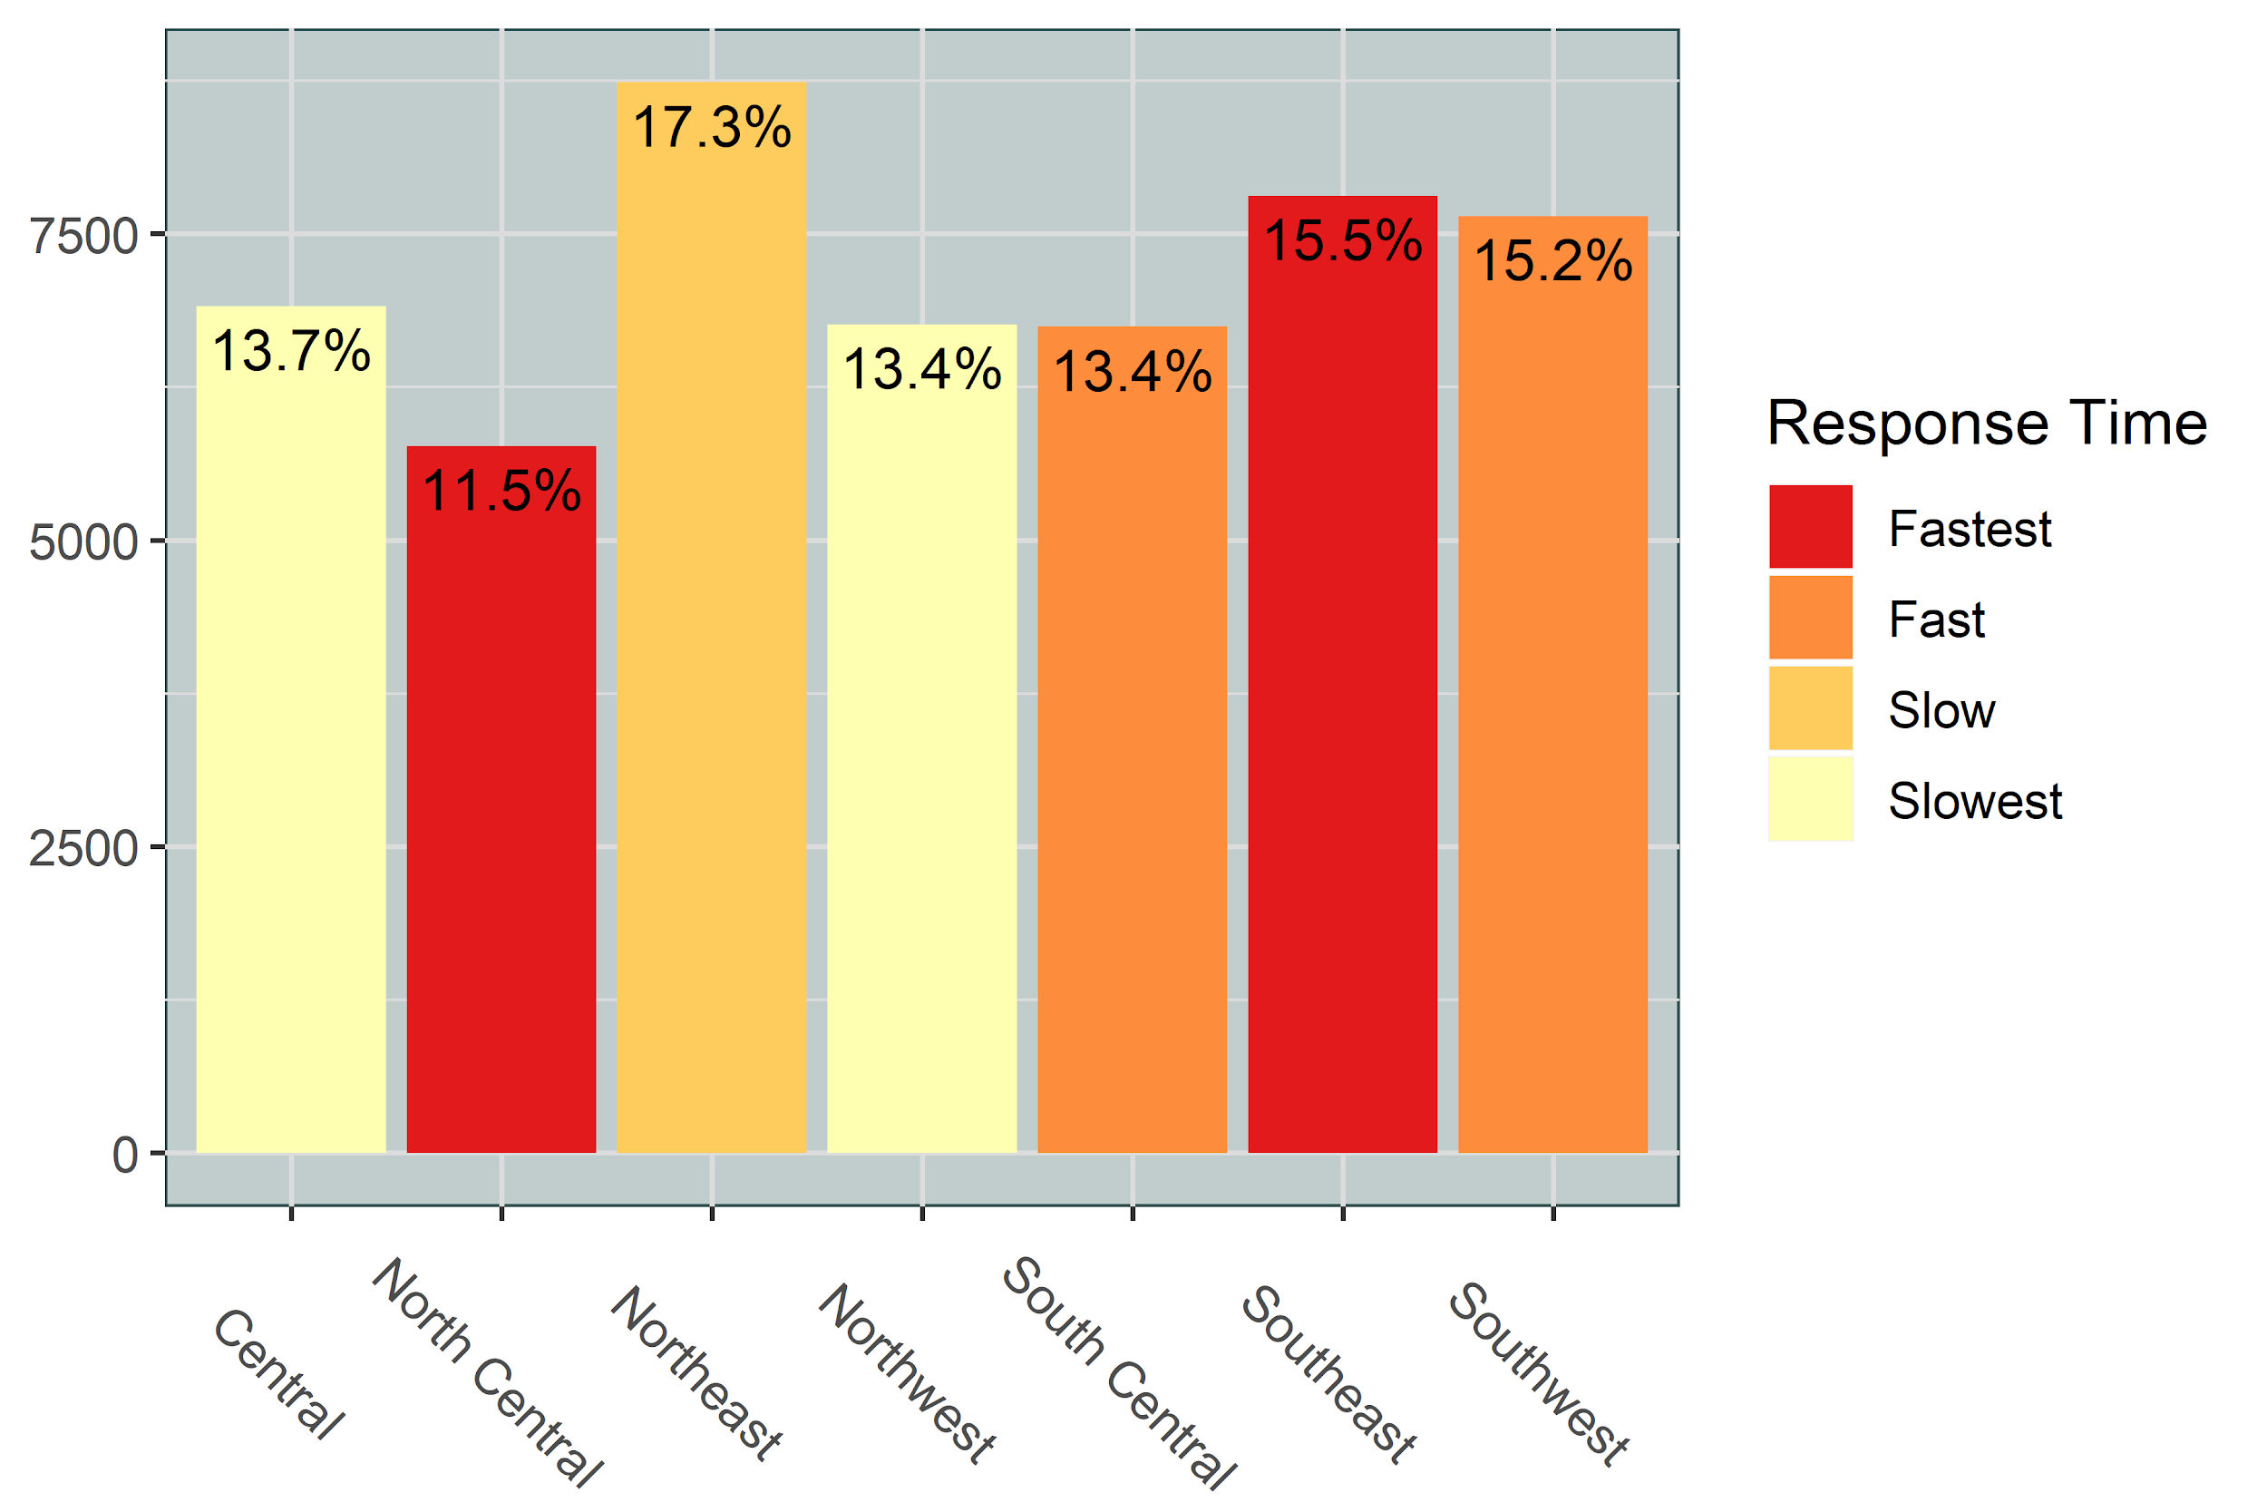
Response Times By Divisions
Notes:
Northeast is where most crimes occur and the department is slow in response.
North Central is where less crimes occur in comparison to others, and turns out as Fastest division.
North Central and South Central came out as the Fastest Divisions in response times While South Central and Southwest the Fast ones.
Central and Northwest were the slowest ones.

Slide 28
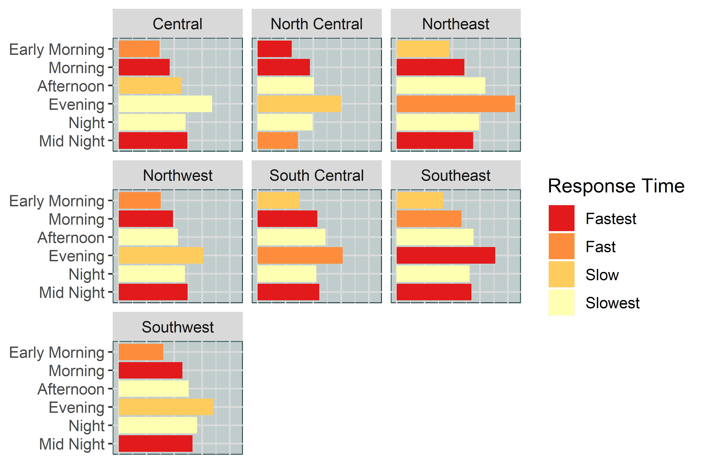
Hourly Response Time of Divisions
Notes:
Southeast is responding fastest in the Evening the time when most crimes occur.
Less crimes occur during Early morning and most divisions were Fast to respond.
All Divisions were Fastest during the Mid Night except North Central.
All Divisions were slow during Afternoon and Night times.
Thank you and now Jay will take over to talk about which category of Victim’s are affected.

Slide 29
Dallas Ethnicity & Race Demographics
White
425k
33%
Hispanic or Latino
378k
29%
Black or African American
316k
24%
Other
180k
14%

Slide 30
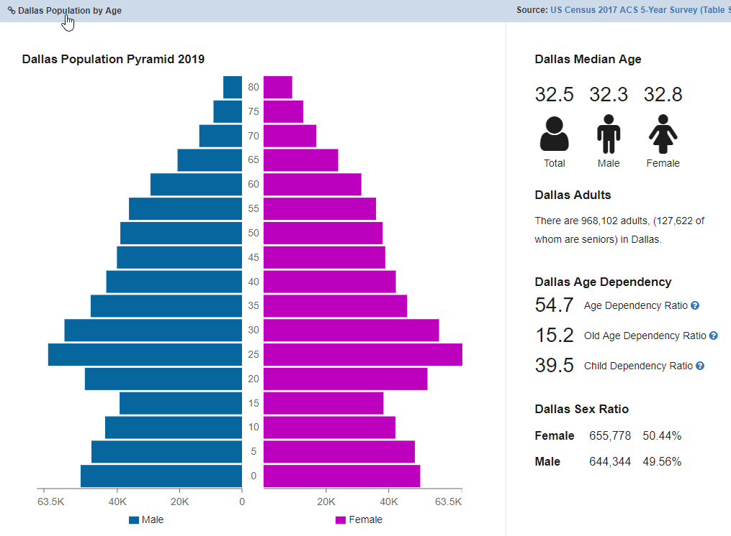
Dallas Age & Sex Demographics
 |  | Male | Female
Teenager | 19 & Younger | 185k | 190k
Young Adult | 20 - 34 | 230k | 220k
Middle Age | 35 - 54 | 150k | 155k
Elderly | 55 & Older | 80k | 90k
Total |  | 645k | 655k

Slide 31
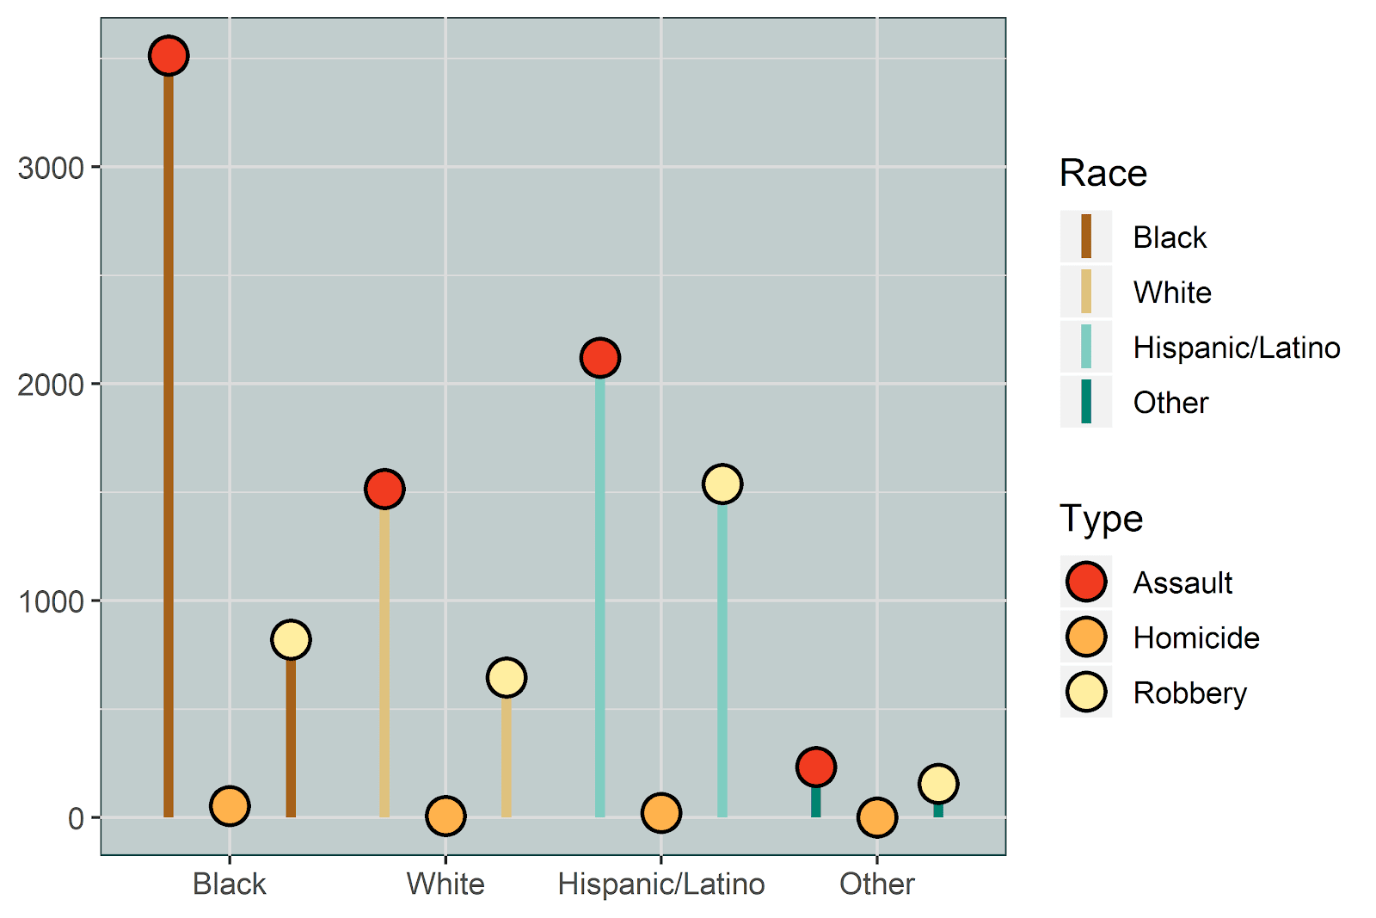
Which race is targeted the most?

Slide 32
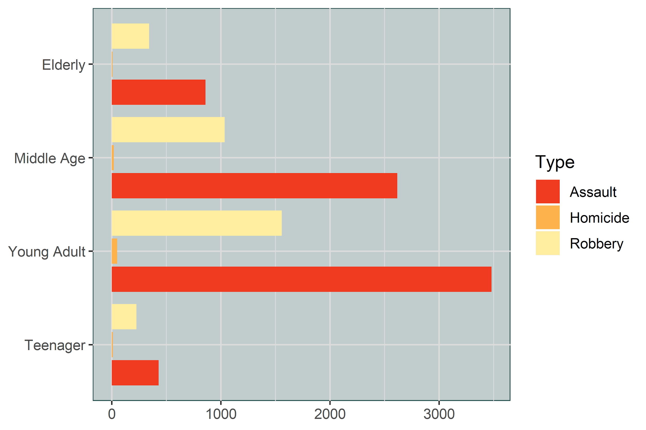
Which age group has most violent crimes?

Slide 33
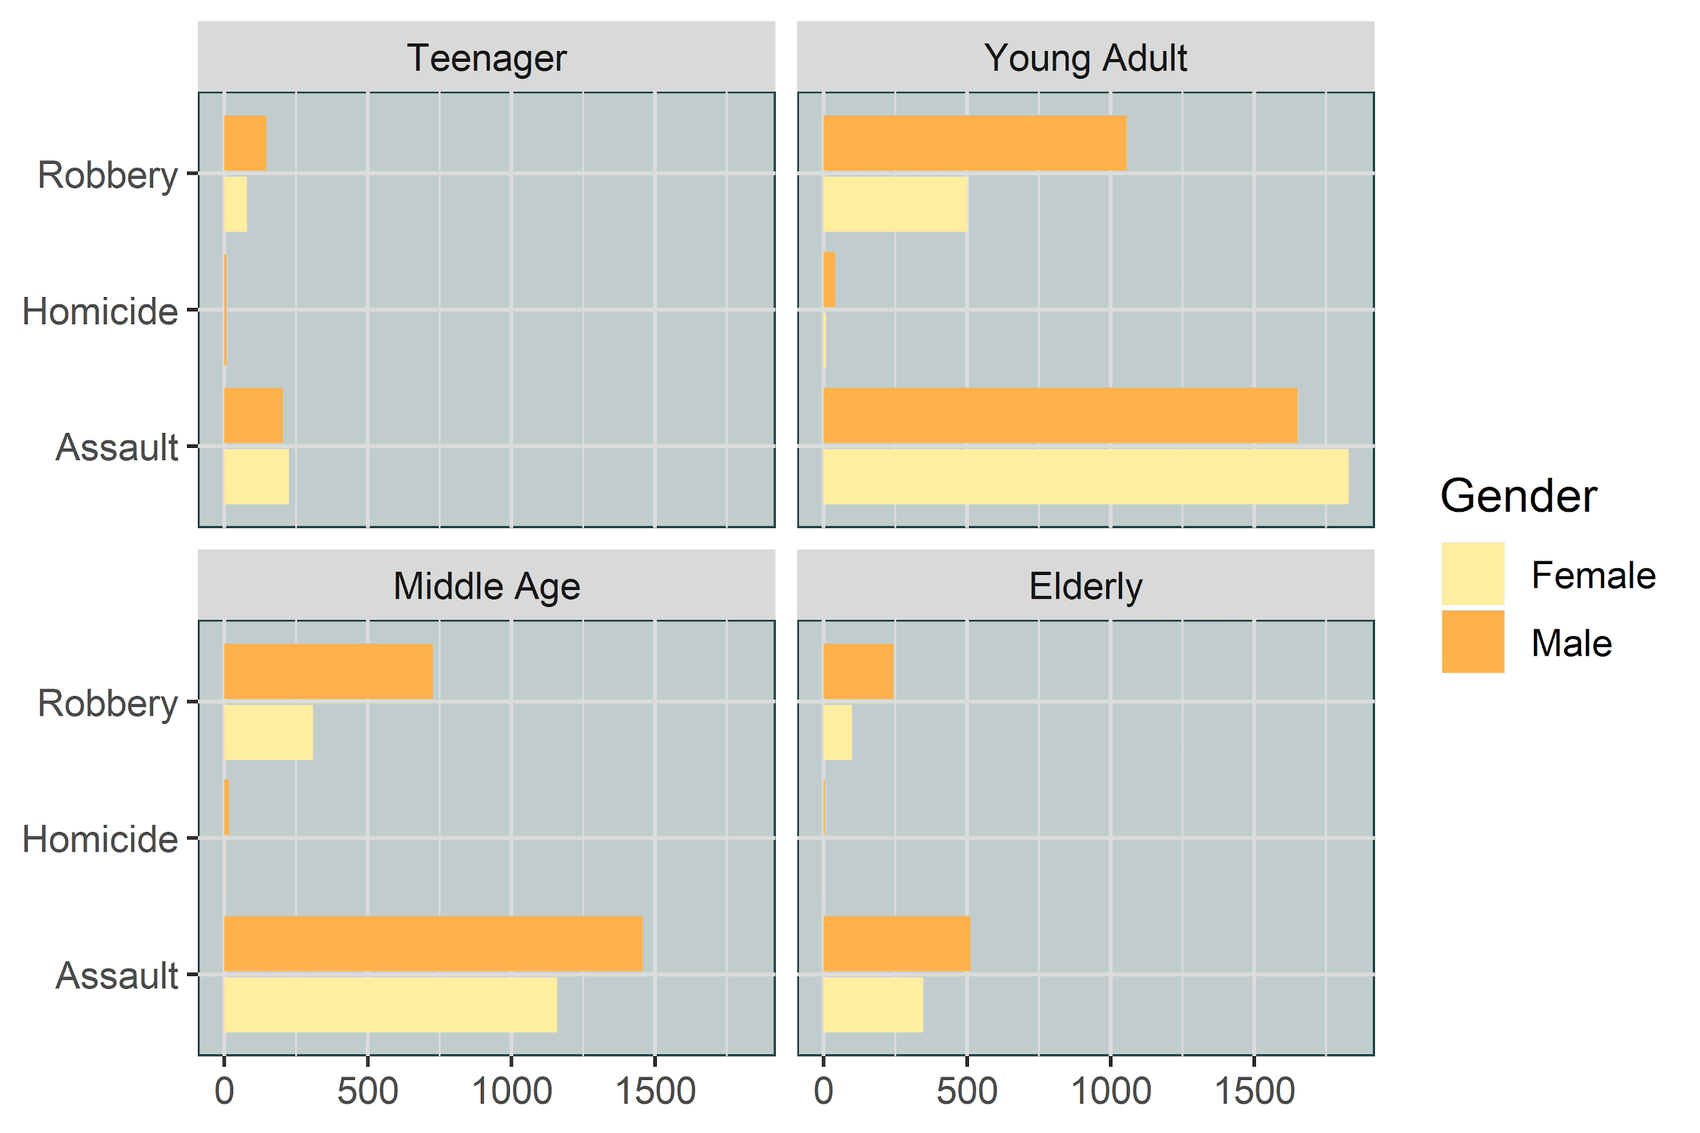
Which age group and gender have most violent crimes against them?
Notes:
sexual assaults are not included in data

Slide 34
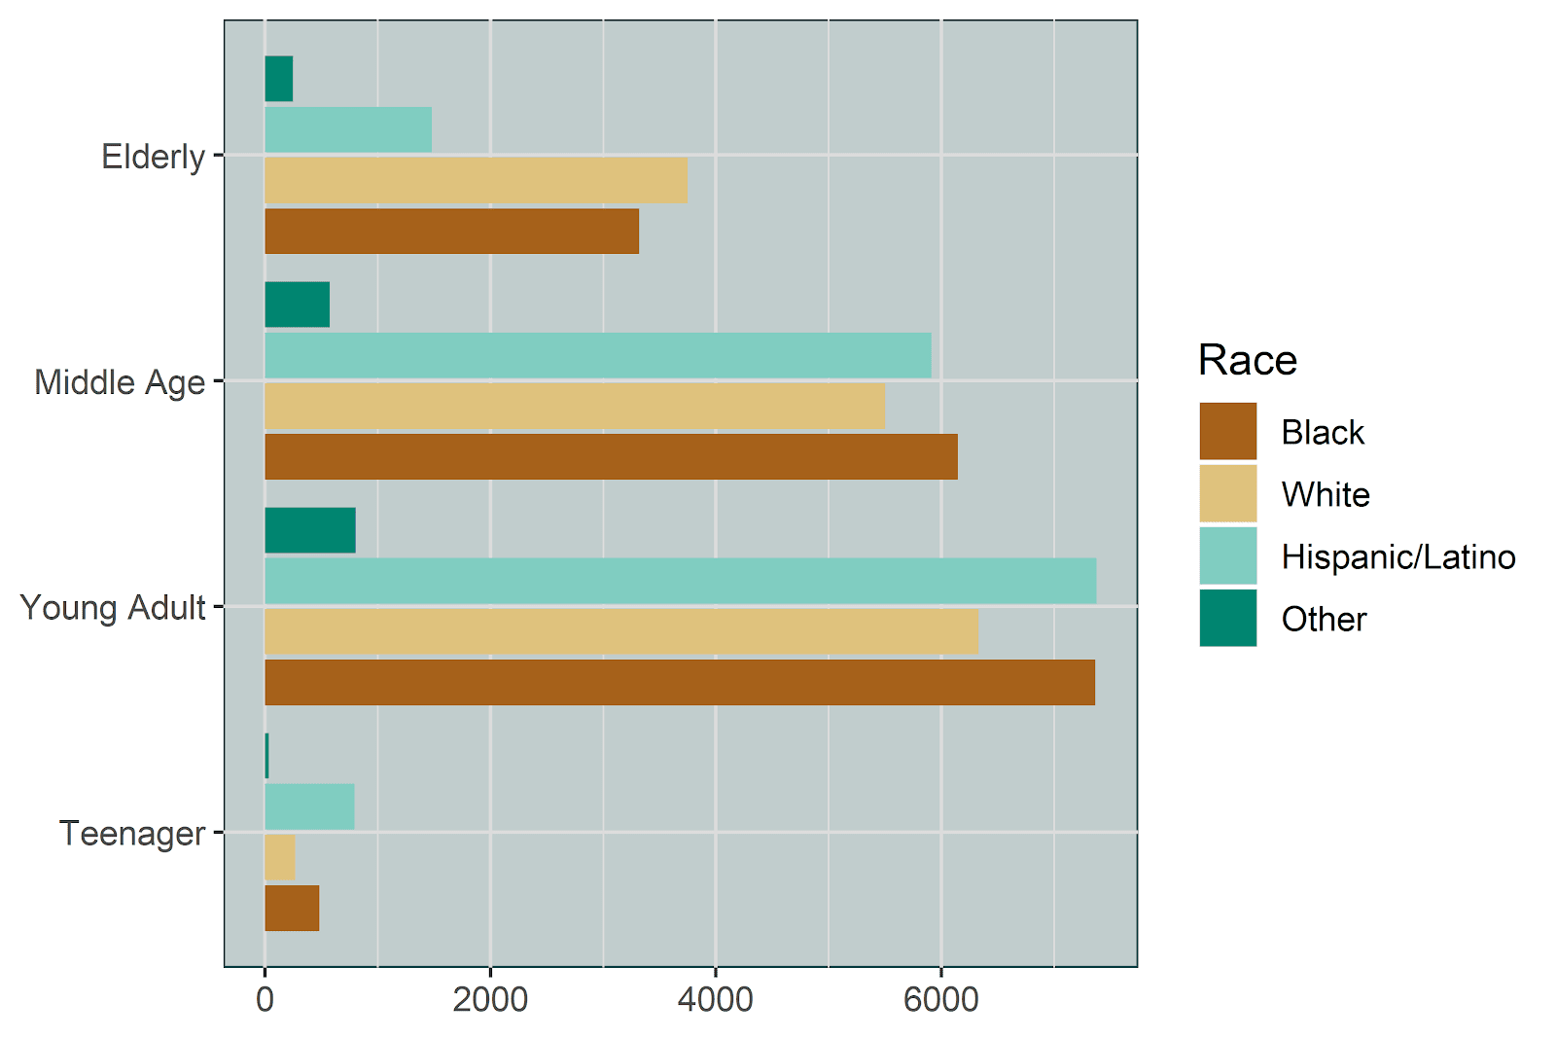
Which age group and race has the most violent crimes against them?

Slide 35

Conclusion
2018 dataset
Violent crime and crime by Neighborhood
Rates of crime over time
Response times by officers
Demographics of Dallas
Notes:
Is this slide needed?

Slide 36
Conclusion - Victim Profile
Age Group | Young Adult (Age 20-35)
Gender | Male
Race | Black
Neighborhood | Southeast
Day of the week | Wednesday - Thursday
Month | July - September

Slide 37
Fastest Segment Served
Neighborhood | North Central and Southeast
Day of the week | Saturday - Sunday
Month | June - August
Safest Segment Served
Neighborhood | North Central
Day of the week | Tuesday - Wednesday
Month | January - April
Notes:
Quick response time versus low crime

Slide 38
Conclusion
Address officer location to trouble areas
Staffing levels at times when crime and violent crime is at its highest
In addition the most violent crime divisions and lower response times could be addressed with change in staffing schedules
Community outreach to communities where we see the most crime occurring to help reduce the number of incidents.
Looking to move to Dallas consider the profile and response times by neighborhood

Slide 39
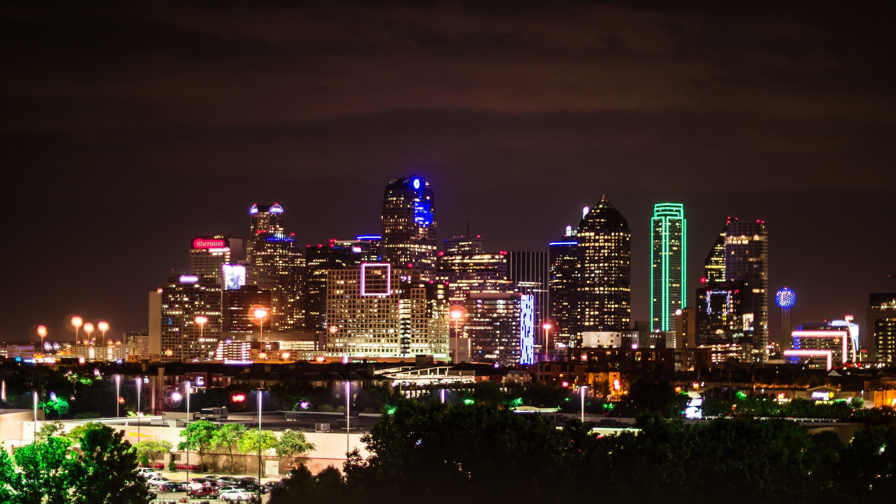
THANK YOU
Notes:
Thank you for your time and attention. Please reach out to Programming in R with Sam Burer Group 6 if you have any questions.

